Slide 1
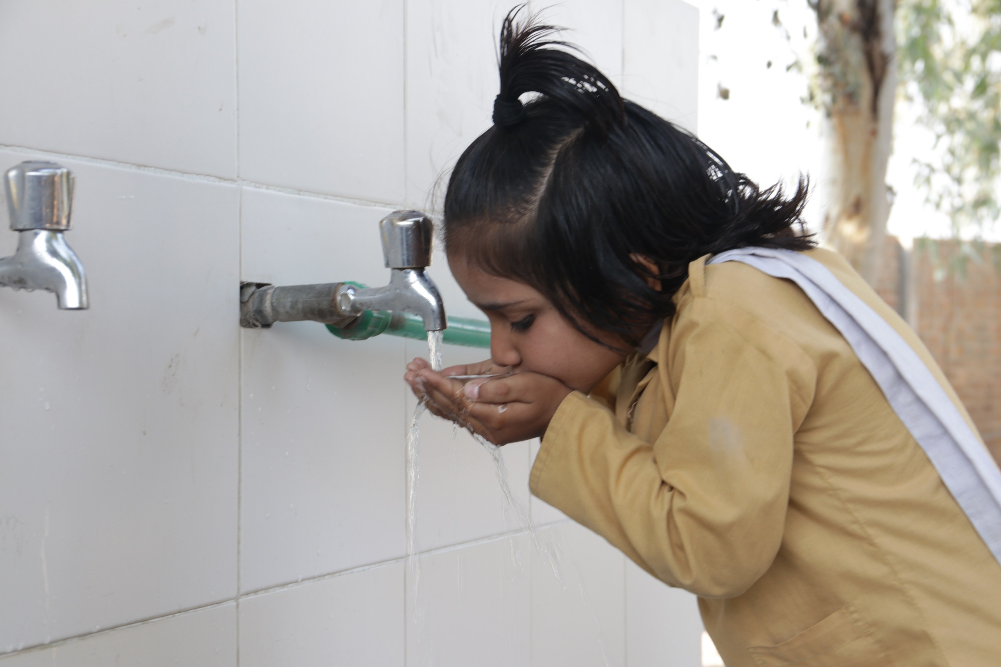
Aab e Rehmat
New Water Plant Installation Proposal FY2023-24
Head Office: Plot No. 20, Sector – 14, Korangi Industrial Area, Karachi | UAN No.: +92-21-111-823-823
Website: www.tcf.org.pk | Email: info@tcf.org.pk
Pakistan Registered Charity No. 0037144 | Company No. K-06597

Slide 2
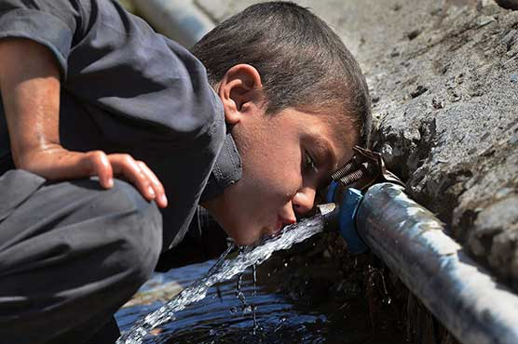
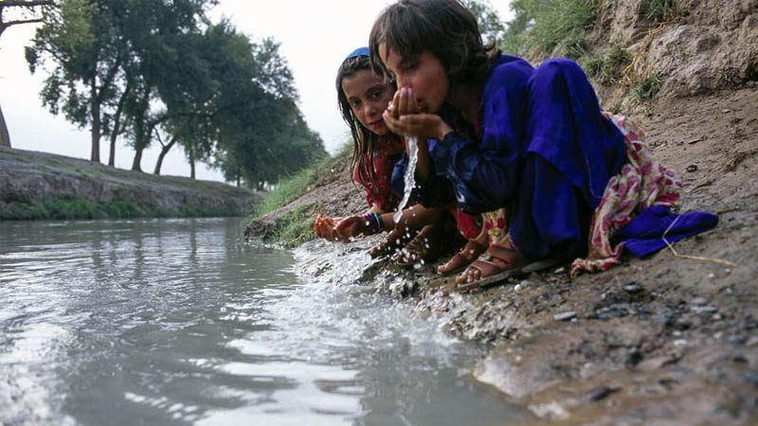
The ‘Clean Drinking Water’ Problem
About 20% of the whole population of Pakistan has access to safe drinking water. The remaining 80% of population is forced to use unsafe drinking water due to the scarcity of safe and healthy drinking water sources.
It is estimated that, in Pakistan, 30% of all diseases and 40% of all deaths are due to poor water quality.
https://www.ncbi.nlm.nih.gov/pmc/articles/PMC5573092/
Access to clean drinking water is a fundamental human right.
The United Nations has identified access to clean drinking water under Sustainability Development Goal #6: Ensure availability and sustainable management of water and sanitation for all.
Prevalent water borne diseases include diarrhea, typhoid, jaundice, kidney stones as well as skin ailments.
Lack of access to clean drinking water at schools and in homes, makes children vulnerable to water borne diseases.
Frequent absences from school lowers a child’s ability and opportunity to learn. In turn, low student attendance levels means the school’s impact potential is not being realized.

Slide 3
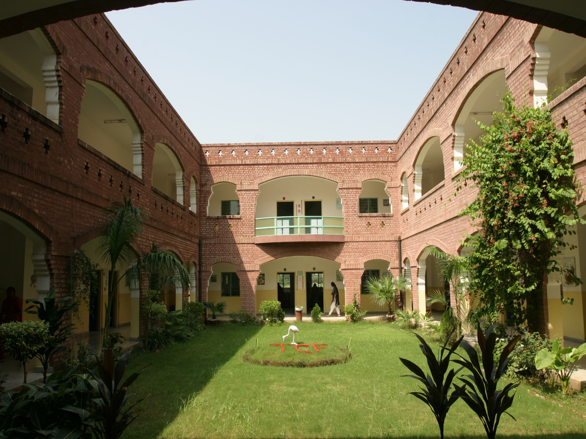
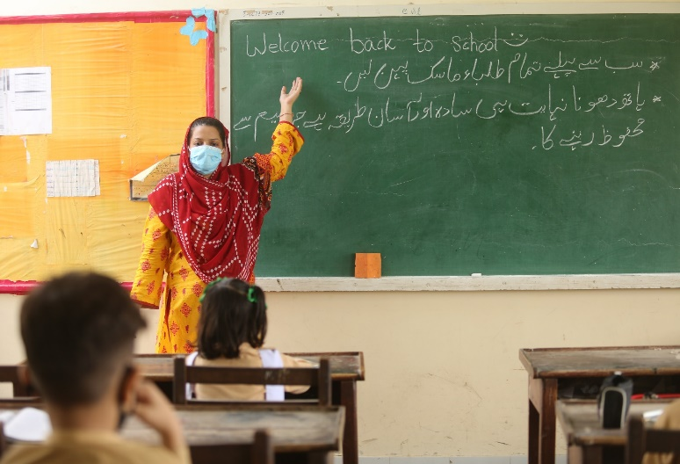
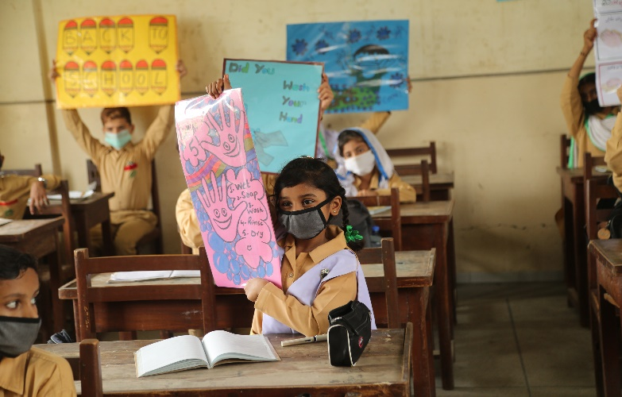
The Citizens Foundation (TCF)
Founded in 1996, TCF is a non-profit, running the largest network of low cost private schools in Pakistan, with 1,833 school units across 700 locations.
TCF’s mission is to remove barriers of class and privilege to create agents of positive change: well-rounded, motivated, and capable individuals who will not only be able to steer themselves and their families out of poverty but also seek to improve the future of their communities and society at large.
48% of TCF’s 280,000 students are girls, surpassing the national average of 39%. To maintain this, TCF hires only women as faculty, making it one of the largest employers of women in the country.
Over 53,000 children have graduated from TCF schools to date, with over 90% transitioning to intermediate education.
Beyond schools, TCF leverages its infrastructure and network to uplift the communities it works in. The Community Development Unit (CDU) manages programs that promote poverty alleviation, preventative health, and social development in areas where TCF schools are located.

Slide 4
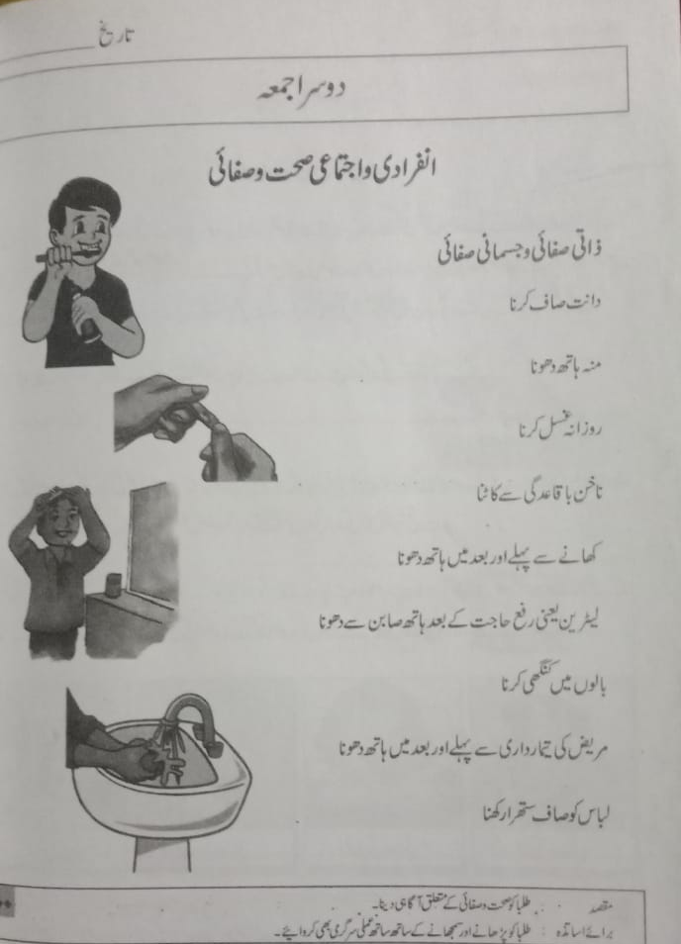
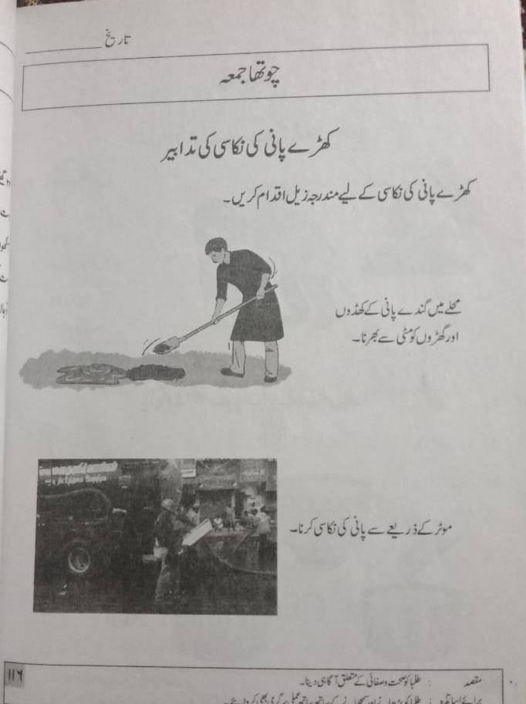
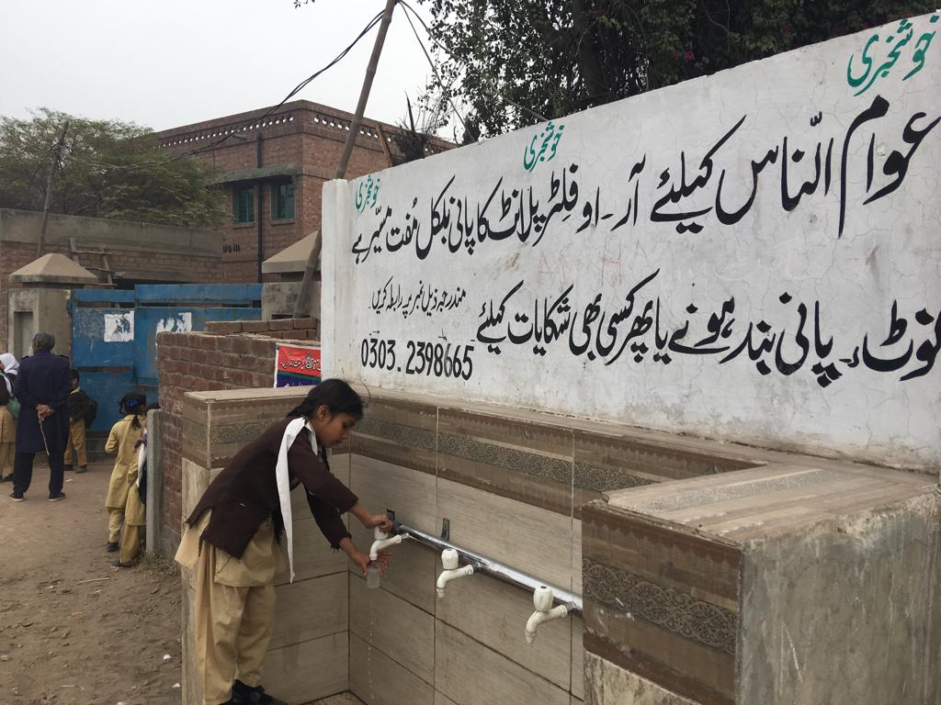
Environment & WASH (water, sanitation, health) Awareness at TCF:
School Curriculum for TCF Students:
Elements in the environment (plants, animals, air, water, weather, etc.)
Biodiversity (interaction of the elements in the environment)
Pollution, pollutants and harmful activities that cause pollution (natural and human activities, including global warming etc.)
Aagahi – Adult Literacy Curriculum for community women & girls:
Personal Hygiene
Cleanliness of Household and Community
Disease Prevention

Slide 5
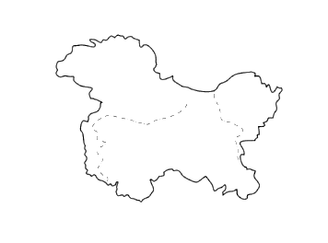
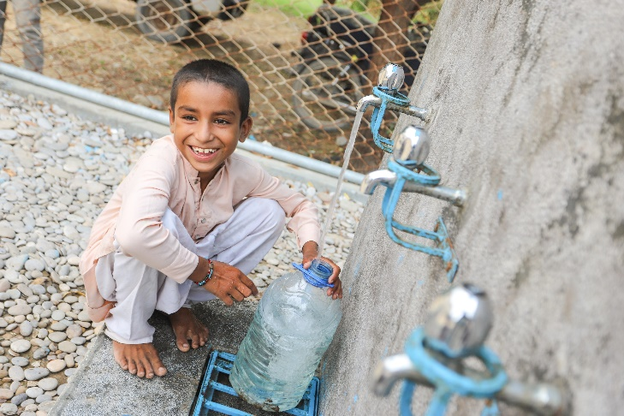
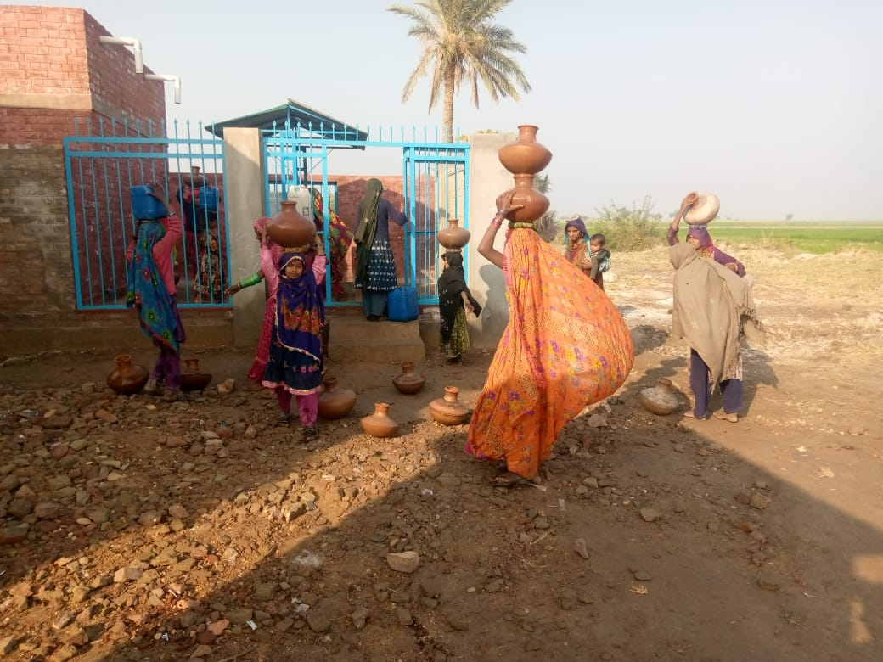
Current Portfolio – for clean drinking water provision
Water filtration plants at 32 TCF Schools:
Across Punjab (20), Sindh (11) and Balochistan (1)
20 water plants are solar-powered (two-thirds)
10 are Reverse Osmosis (one-thirds)
Physically located within TCF school premises
Serving ~50,000 people daily
Clean water for school and community, free of cost
Punjab
Lahore
Kasur
Mianwali
Muzaffargarh
Narowal
Rawalpindi
Sargodha
Sheikhupura
Balochistan
Sindh
Karachi
Dadu
Naushehro Feroze
Umerkot
Lasbela

Slide 6
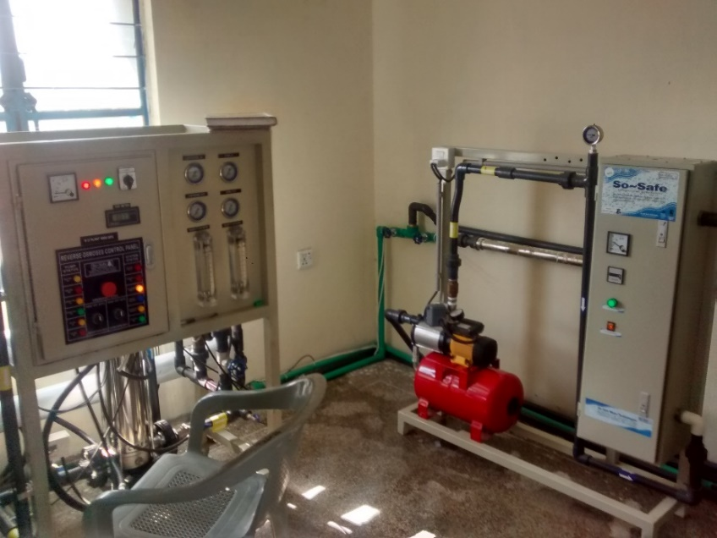
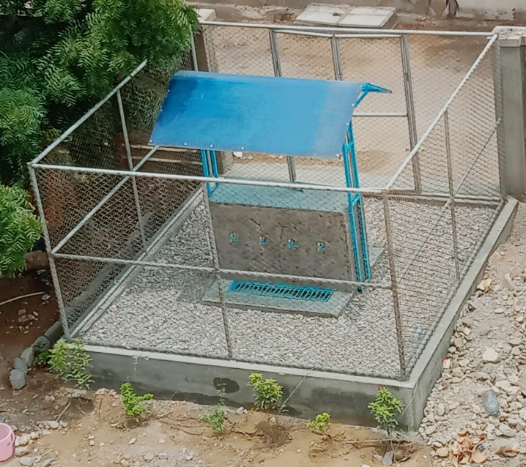
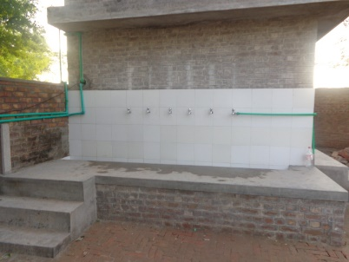
Operation, Supervision and Monitoring of Water Plants at TCF Schools
At each of the water plants, a trained Plant Operator works for 8-10 hours
Output reported daily, maintenance reported weekly by the Plant Operator via mobile SMS
The Program Team reviews the data to determine repairs and upgrade needs.
Plant repairs and upgrades are carried out by Plants’ Technicians.
The Program Team conducts quarterly monitoring visits to each plant, while the TCF Principal provides field-level oversight.
Water quality is checked on a bi-annual basis through comprehensive lab tests conducted by the Pakistan Council of Research in Water Resources (PCRWR).

Slide 7
Our Request – Installation of a Water Plant
We install solar-powered water plants in TCF schools that do not have a source of clean drinking water, and there is dearth of clean water sources in the nearby communities as well.
The proposed water plant of 5,000 GPD will have the capacity to serve about 3,000 – 5,000 individuals on a daily basis while operating for 8-12 hours.
Contribution of PKR 5,200,000 will completely support the installation and running of the water plant for one year.
The plant will provide clean drinking water to the school and the community.
A donor acknowledgement plaque will be placed at the plant room premises.
Your donation will support:
Construction of Water Plant Facilities | PKR 1,500,000 | one-time
Water source & storage | PKR 300,000
Water machinery storage | PKR 400,000
Water provision to school | PKR 200,000
Community water collection point | PKR 600,000
Water Filtration Technology | PKR 900,000 | one-time
Reverse Osmosis/Filter plant | PKR 900,000
Solar Power System | PKR 2,000,000 | one-time
Water Plant Running Expense | PKR 800,000 | 1 year
Operations | PKR 285,000
Maintenance | PKR 250,000
Quality Assurance | PKR 115,000
Management | PKR 150,000
Total Requested Amount | PKR 5,200,000

Slide 8
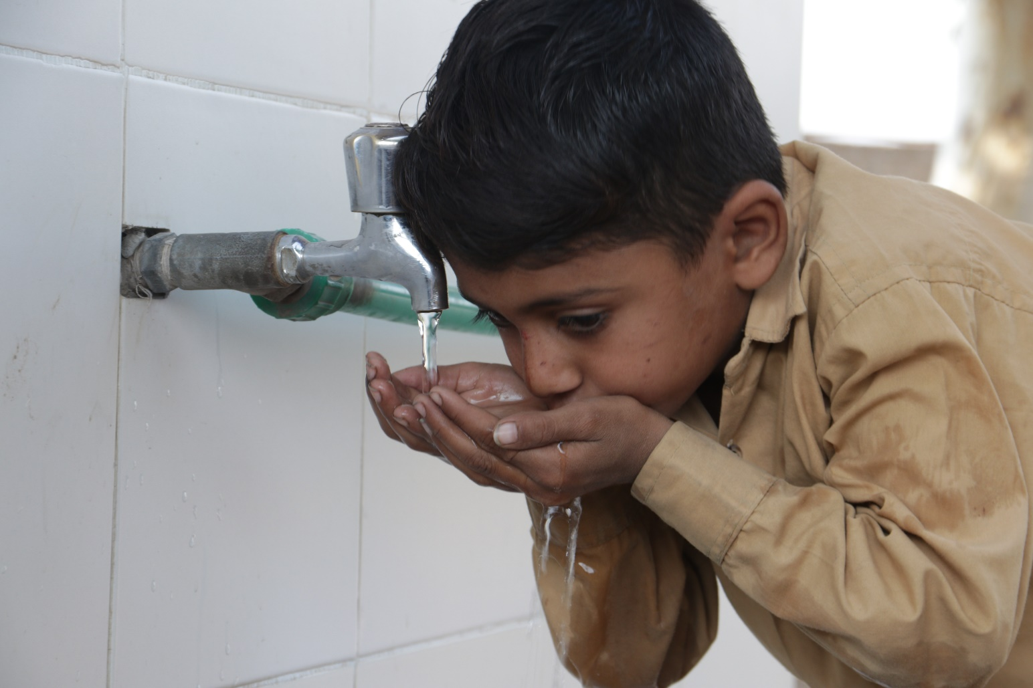
Thank you for supporting
Aab e Rehmat at TCF
so we can provide
clean drinking water
to our schools and communities!
https://www.tcf.org.pk/community-programmes/ cdu@tcf.org.pk

