Slide 1
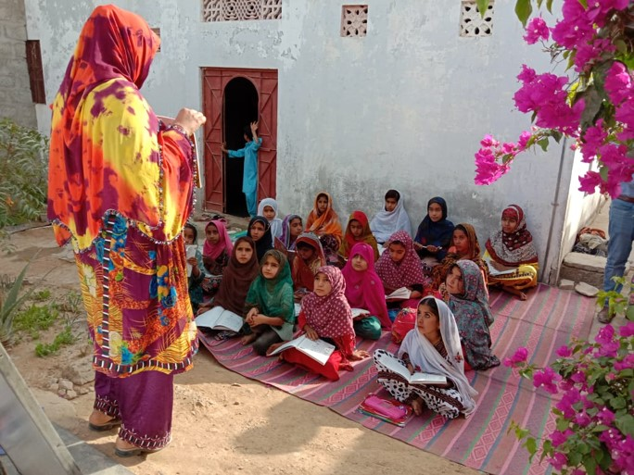
Aagahi (“Awareness”)—Illuminating Lives Through Literacy
Head Office: Plot No. 20, Sector 14, Korangi Industrial Area, Karachi UAN No.: +92-21-111-823-823
Website: www.tcf.org.pk | Email: grants@tcf.org.pk
Pakistan Registered Charity No. 0037144 | Company No. K-06597

Slide 2
About Aagahi
Vision:
Literate and well-informed communities around TCF schools.
Mission:
To enable community women and girls around TCF schools to attain literacy and numeracy skills, enabling them to make better decisions, increase their self-confidence, and bridge educational gaps.
Impact:
To date, Aagahi has imparted essential skills of literacy and numeracy to over 174,000 community women and girls all over Pakistan.

Slide 3
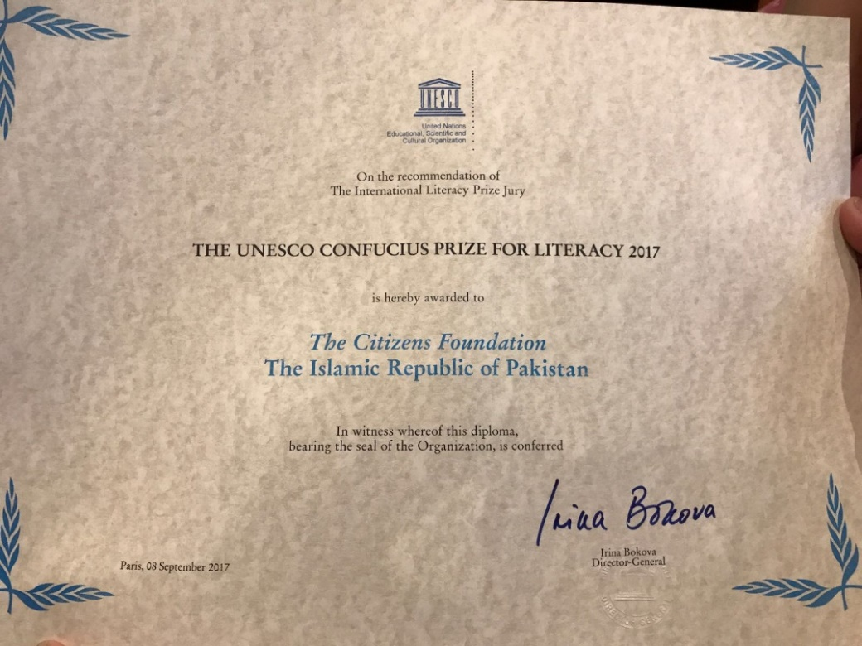
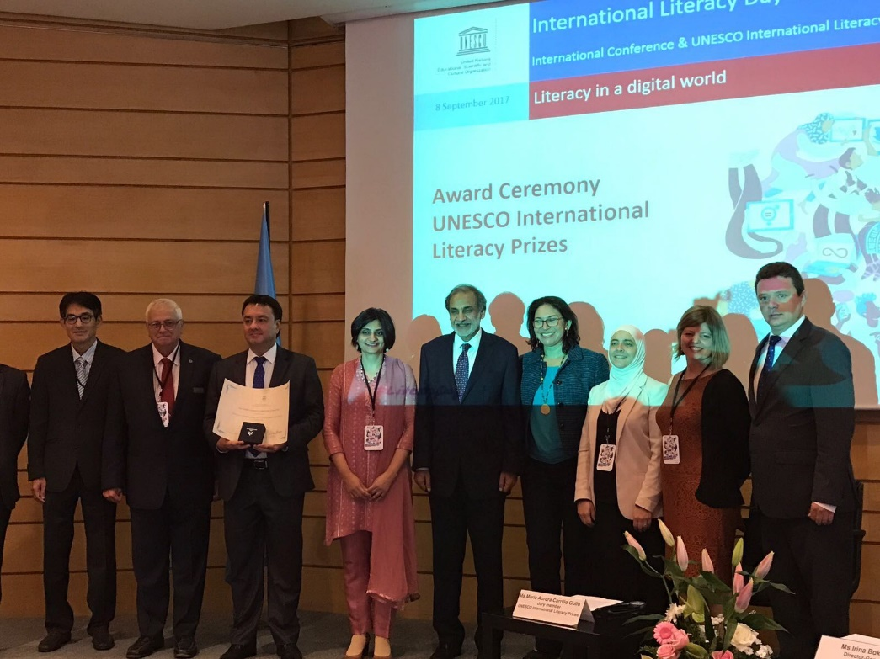
Winning The UNESCO Confucius Prize for Literacy 2017
TCF received the UNESCO Confucius Prize for Literacy 2017 for Aagahi on September 8th, 2017. The prize was awarded at an official ceremony at the UNESCO Headquarters in Paris on International Literacy Day.

Slide 4
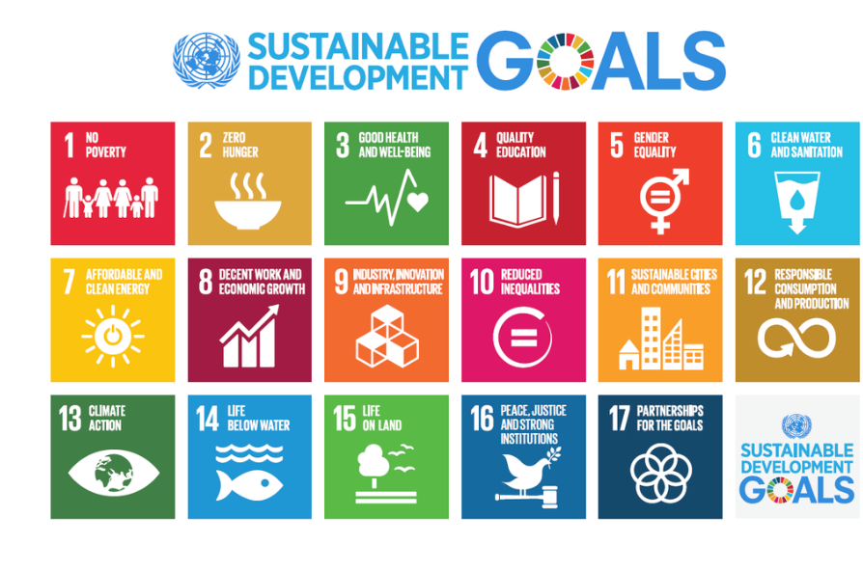
Alignment with the UN SDGs

Slide 5
Program Components
Four Urdu books covering letter recognition and formation, sentence writing, English alphabets, arithmetic, health, hygiene, and financial literacy
1 Master Trainer
Daily 2-hour classes over a 3-month period
Certification by Literate Pakistan Foundation
1 Trained Teacher
Program Beneficiaries
Having minimal to no prior literacy skills
Majority women and girls
Aged 10 to 65
In communities around TCF schools
5

Slide 6
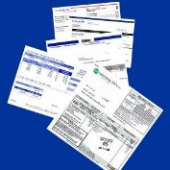
Program Outcomes
Upon completion of the program, an Aagahi learner can:
Write simple letters
Do household budgeting
Understand and pay bills
Read and understand the newspaper, medicine prescriptions, and product labels
Assist their child with homework assignments
Sign documents
Maintain a hygienic and healthy home environment
6

Slide 7
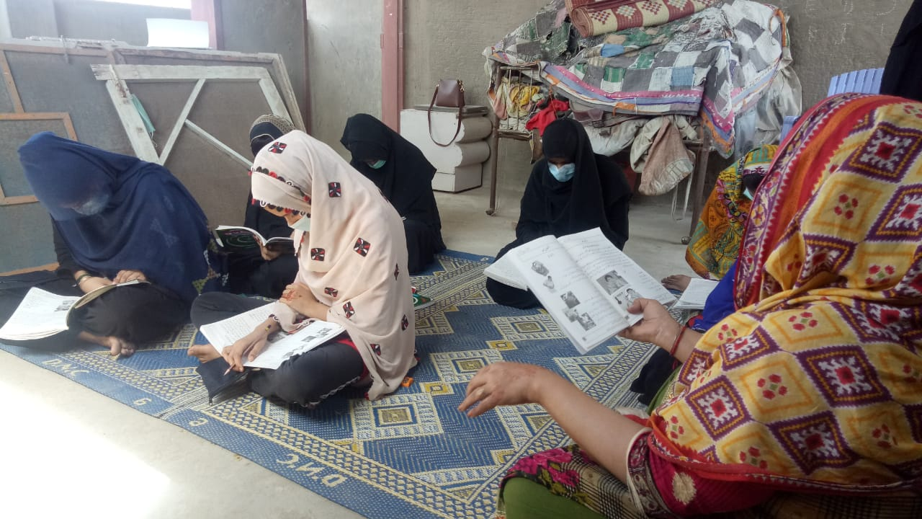
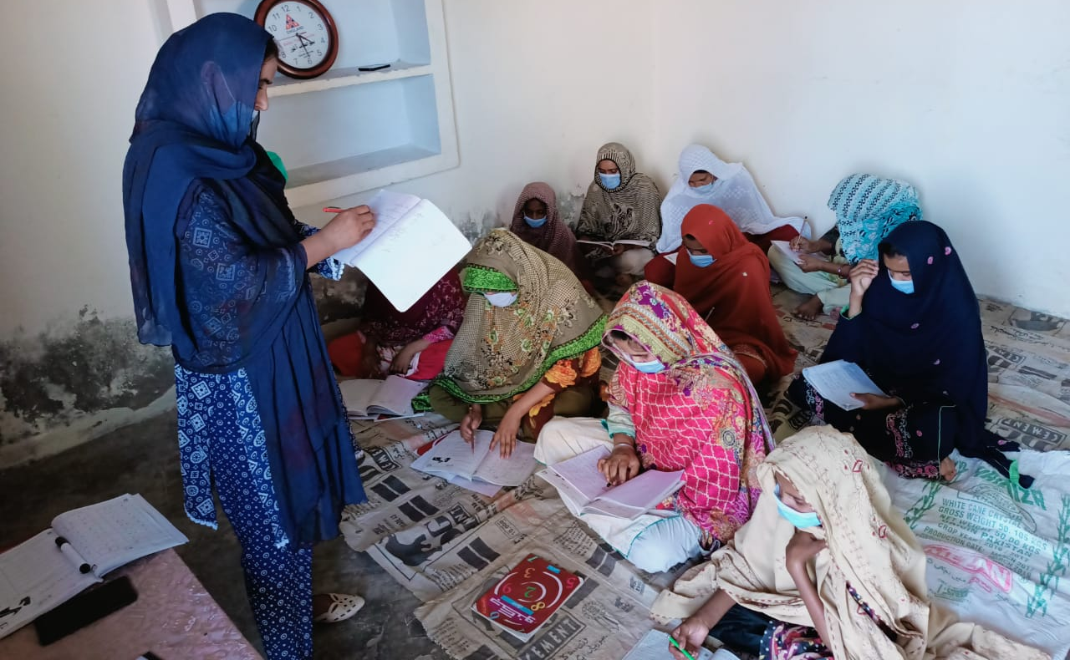
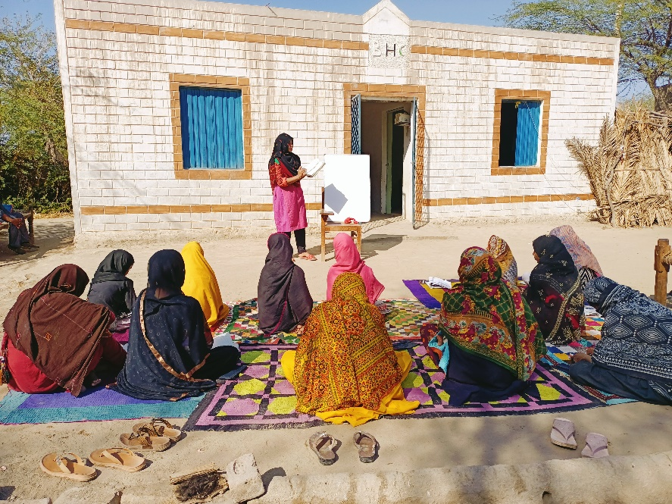
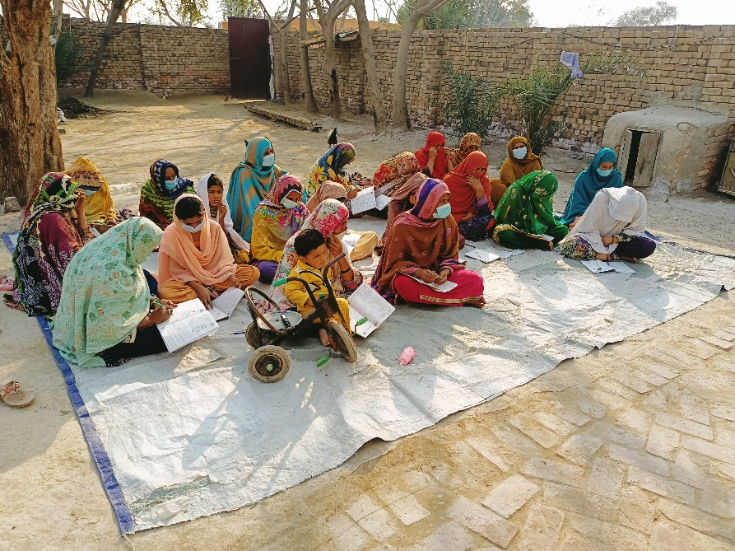
Aagahi Over the Years

Slide 8
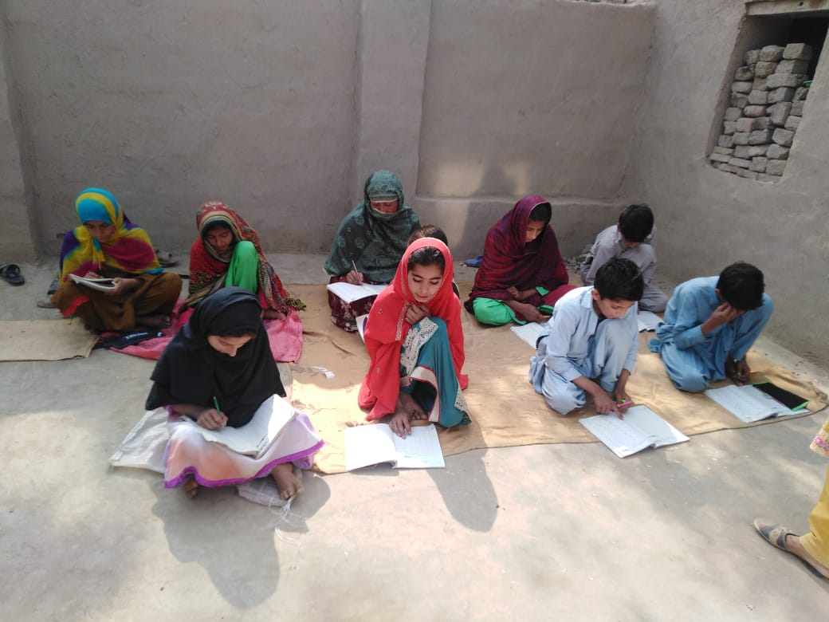
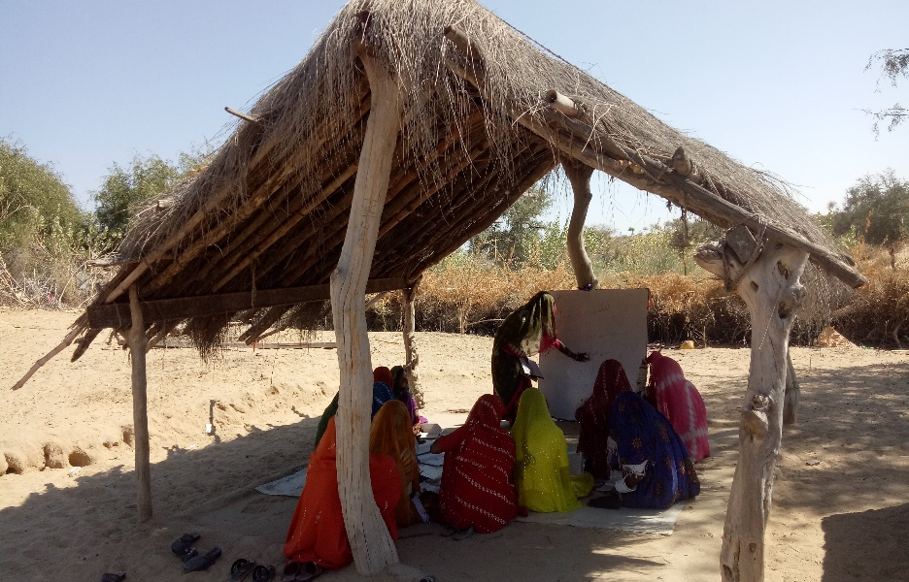
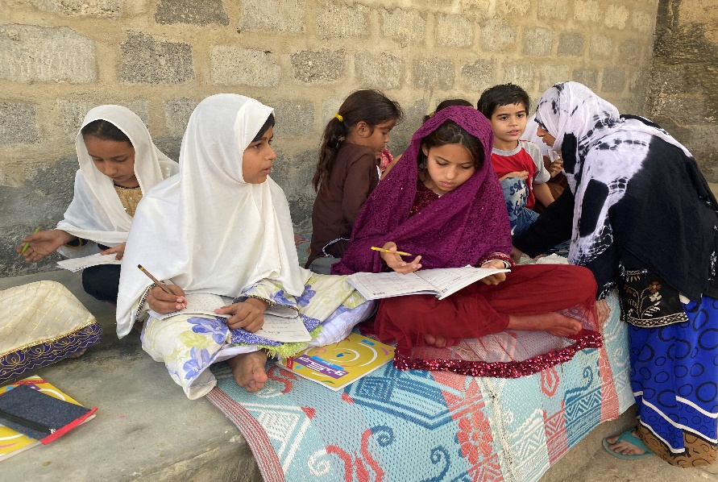
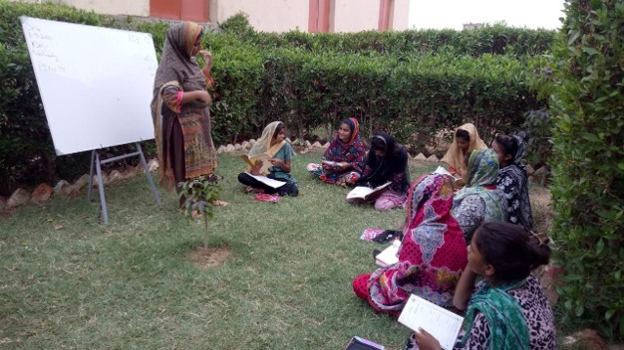
Aagahi Over the Years

Slide 9
Budget 2023–24*
Item | Cost in USD | Percentage of Total Cost
Direct Education Costs (includes Materials and Teachers’ Salaries) | 257,000 | 70%
Field Training Costs | 18,000 | 5%
Field Monitoring Costs | 28,000 | 8%
Research and Development Costs | 16,000 | 4%
Program Management Costs | 49,000 | 13%
Total | 368,000 | 100%
Planned Centers | 2,325
Cost per Center | 160
Cost per Successful Learner | 10
*All conversions are made using an average exchange rate of 1 USD = 280 PKR.

Slide 10
Support for Aagahi 2023–24
The Aagahi female literacy program at TCF needs your help! Aagahi is run solely through donations and sponsorships. Your help is needed to eradicate illiteracy from Pakistan.
A literacy center (Aagahi classroom) has the capacity to enroll up to 20 learners. Support will cover the cost of books, stationery, teacher training, operations and monitoring and evaluation.
-----
Sponsorship Packages:
15,000 USD: 95 Centers with enrollment capacity of 1,900 learners
50,000 USD: 316 Centers with enrollment capacity of 6,320 learners
100,000 USD: 632 Centers with enrollment capacity of 12,640 learners
Progress Reports:
A year-end report (covering activities of July 2023 to June 2024) would be submitted in August 2024.

Slide 11
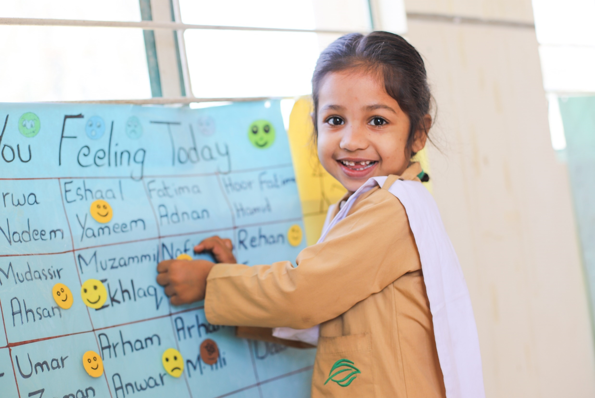
About The Citizens Foundation

Slide 12
Impact Numbers
286,000
Students
14,000+
Female
Teachers
1,921
School Units
across Pakistan
174,000
Women and girls empowered through Aagahi

Slide 13
Alumni Impact
30%
Students scored A/A+
57,000+
Graduates to date
90%
Matriculation pass rate
12

Slide 14
Impact Beyond Basic Schooling
Aagahi
Literacy for community women and girls
Vocational Training
Training community women and girls in tailoring and embroidery
Aab-e-Rehmat
Providing filtered drinking water for communities
174,000+
Learners
3,200
Trainees
19
Centers
48,000
Daily Beneficiaries
36
Filtration plants
Rahbar
Mentoring program for 8th students
Summer Camp
Fun-based learning for primary students (Grades 3, 4, and 5)
15,150+
Mentors
57,150+
Mentees
11,200+
Volunteers
77,400+
Students

Slide 15
