Slide 1
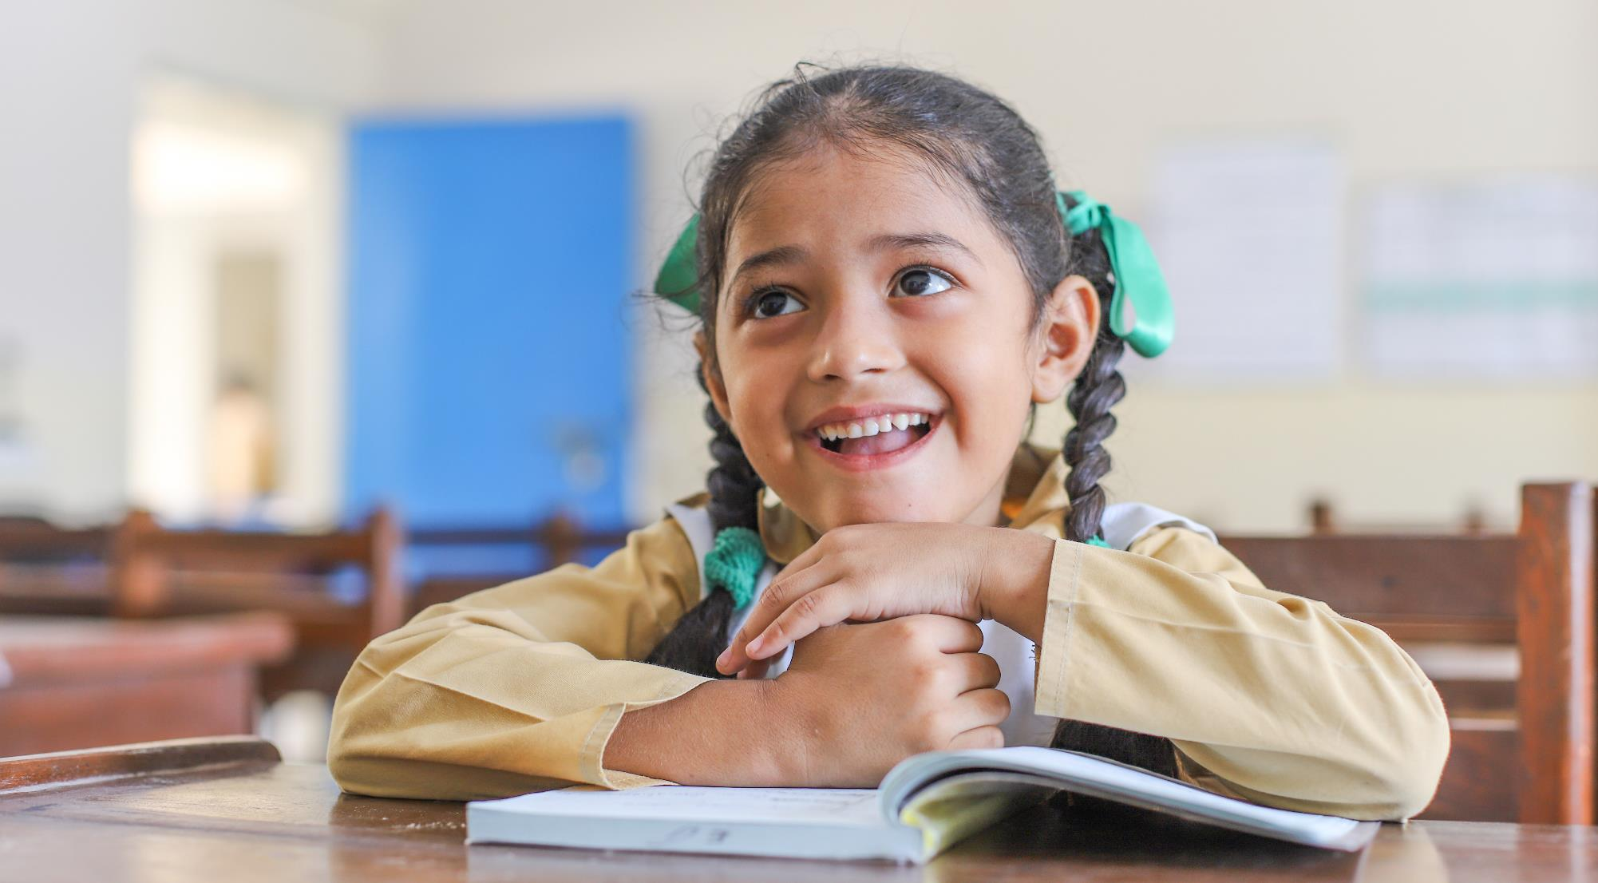
Digital Literacy Programme (DLP)

Slide 2
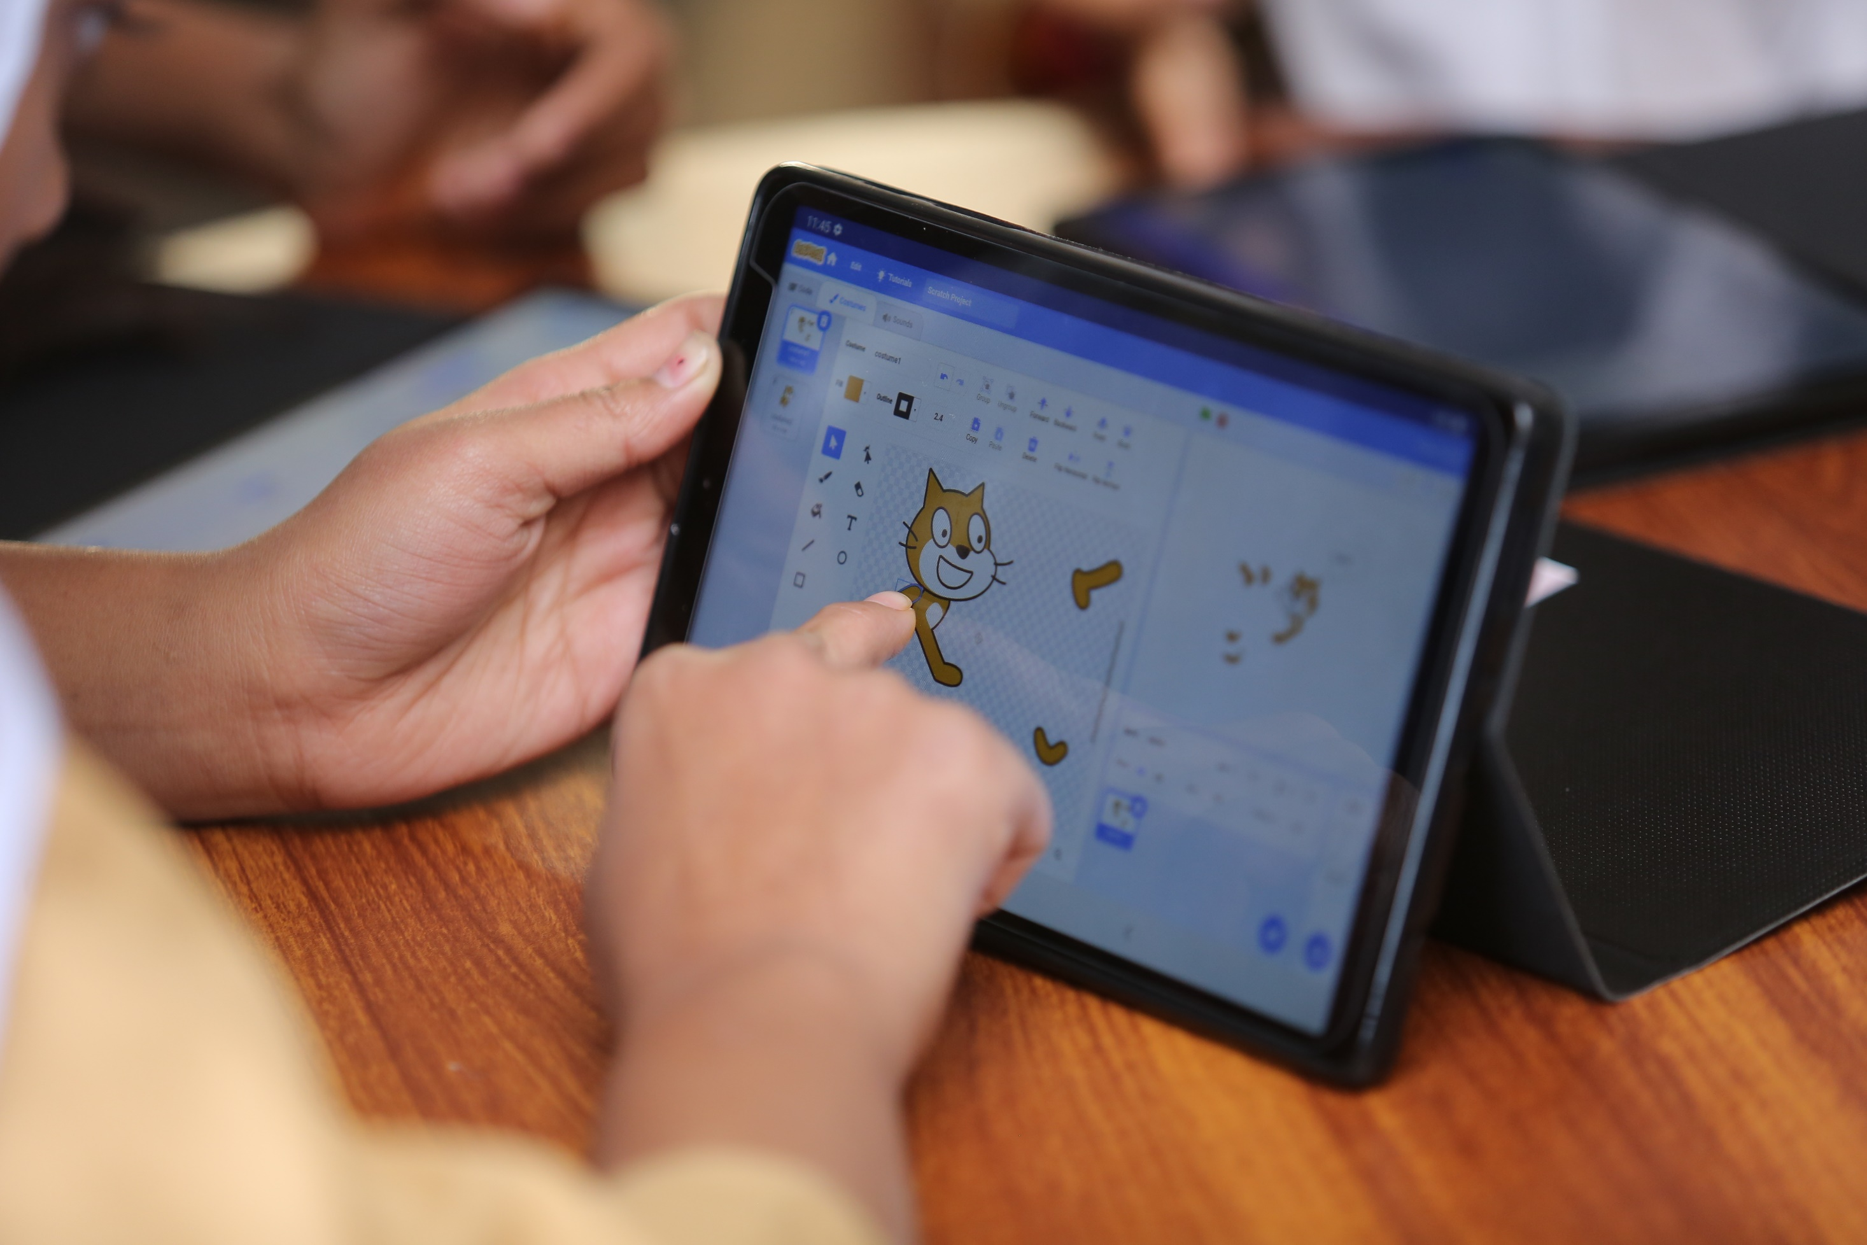
Digital Literacy Programme

Slide 3
Country Context
Pakistan has ranked lower than India, Iran, Sri Lanka and Bangladesh on the Inclusive Internet Index of the Economist Intelligence Unit, placing 68th out of 86 countries surveyed
Pakistan has the second lowest score in the digital literacy environment indicator
Digital Pakistan Policy 2017 vision for Information and Communication Technology (ICT) Education is:
Enhance Primary & Secondary School students capability to construct, hypothesize, explore, experiment, evaluate, foster logical thinking, problem solving, persistence and collaboration by encouraging next generation computing and analytical curricula and ICT tool adoption programs

Slide 4
Curriculum Context
Computer Studies teaching in Pakistan usually encourages rote memorization of instructions and definitions for examinations
The content is outdated with focus on learning hardware connections and understanding softwares which are not the best suited for 21st century skills enhancement
In some areas, teachers struggle to use a computer independently
Employers in Pakistan struggle to find employees with technological and problem solving skills
Technology is dynamic and evolving rapidly. The tools we teach students to use today may be obsolete in ten years. It is necessary to teach students how to navigate digital tools on their own and how to use technology for solving real-world problems

Slide 5
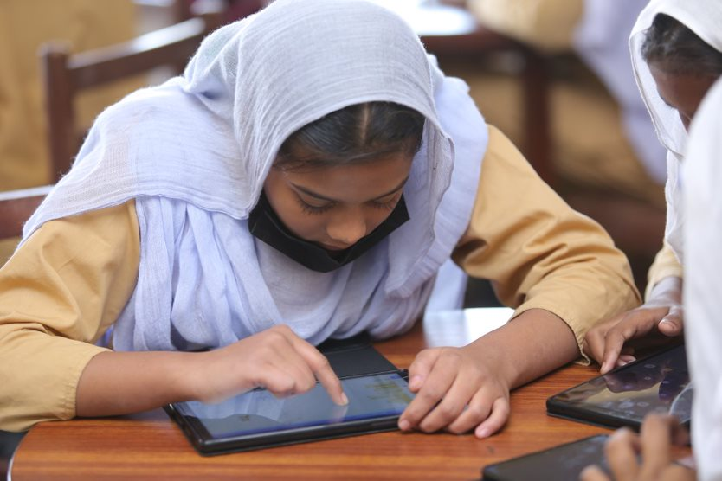
Goal:
To develop a comprehensive computer studies curriculum and infrastructure that enables students to use digital tools and be prepared for the computing-intensive world.
To implement the new curriculum, TCF aimed to revamp its 260 computer labs in secondary schools serving 40,000 students.

Slide 6
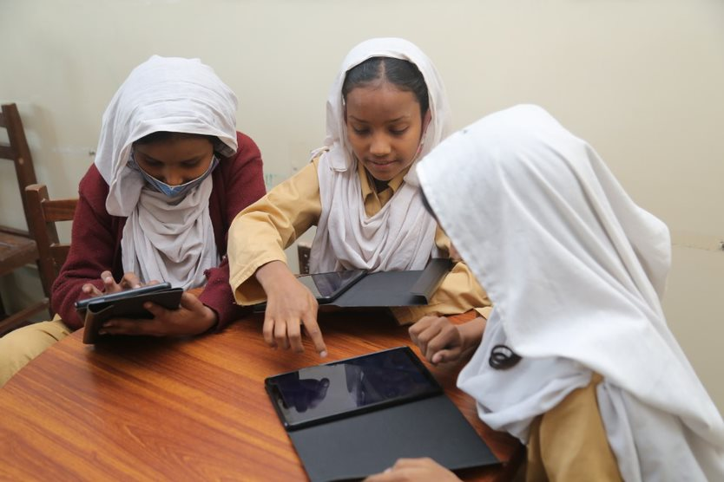
DLP comprises of tablet-based learning and is facilitated by teaching through a large screen.
Key features of the curriculum:
To develop a comprehensive computer studies curriculum and infrastructure that enables students to use digital tools and be prepared for the computing-intensive world
Bilingual Textbooks
Scripted Textbooks
Teacher Capacity Building
Coding from Scratch
MS Office Skills

Slide 7
Important Components of the Digital Literacy Programme
Students are able to develop their 21st century tinkering skills (learning, exploring and becoming comfortable with technology), logical thinking skills (develop problem solving skills & pipeline logical reasoning) and programming skills (design digital solutions to problems)
Opportunity for individual practice compared to the group practice that students get in the current computer labs which are set up
Tablet can provide an opportunity for 1-1 learning across critical subjects beyond DLP within the secondary schools
Repair downtime will be minimal as the tablet is more quickly replaceable than resolving issues for non-functioning computers
Cross-curriculum link with other subjects, especially Mathematics & Science

Slide 8
6 Strands of TCF’s Digital Literacy Programme
ICT Fundamentals
Students develop an understanding of how different components are combined to develop a computing device.
Digital Skills
Students improve their productivity by understanding appropriate utilization of word processing, spreadsheet, presentation, online communication, and other applications.
Digital Citizenship
Algorithmic Thinking and Problem Solving
Programming
Students develop the ability to implement solutions to computational problems through coding and other digital methods (using Scratch).
Students develop the ability to implement solutions to computational problems through consistent utilization of coding and development environments of increasing complexity.
Students develop their perspective on social responsibility, ethics & privacy, cyber safety, cybercrime laws & policies in the digital age
Entrepreneurship
This domain consists of advanced optional student learning outcomes only, where a student is encouraged to use problem-solving skills to solve a consumer problem or market need

Slide 9
Inside TCF’s DLP Lab
Key features of the lab:
Round tables with 3 chairs per table for students to sit together in a peer-learning model (each student has their own individual goals but they learn from other students in a comfortable group setting)
42 tablets (39 for the students, 1 for the teacher and 2 backup)
Green Board
White Board
LED Screen
3 Desktop computers (to familiarize students with desktop computers since they are expected to use it in their Board exams)
Storage cabinet with lock and key for storing tablets
Charging devices
Speakers
Dongle to connect LED with table
ABIC Framework implemented:
Anticipation – revising old concepts + introducing new ones using real life examples
Building Knowledge – immediate practice of the students on the concepts learnt. Transition between tablets and teacher’s lesson takes place through multiple hand gestures
Independent Practice – each student has access to a tablet on which they immediately practice the concepts taught and then discuss with their peers and the teacher
Consolidation – review of the concepts taught in the class to understand where the students are by the end and helps the teacher plan effectively for the next lesson

Slide 10
Journey of the Digital Literacy Programme at TCF
2018
Pilot of the new curriculum
January 2021
Pilot through Tablets
August 2021
Roll-out of Grade 6 through Tablets in Southern regions which included Karachi, Hub and Gwadar schools
2024-25
August 2023
August 2022
Roll-out of Grade 6 in remaining regions and Grade 7 in Southern regions of Pakistan
Roll-out of Grade 8 in remaining regions
Roll-out of Grade 7 in remaining regions and Grade 8 in Southern regions

Slide 11
Funding Request
In response to the urgent and critical need to support the digital literacy and skills of children in Pakistan, we utilized our unrestricted pool of funding for the DLP. Your funding will play a crucial role in replenishing these resources, allowing us to not only maintain but also expand and enhance our current programs. The cost for 1 lab is USD 8,000. Currently we need funds for 100+ labs across Pakistan.

