Slide 1
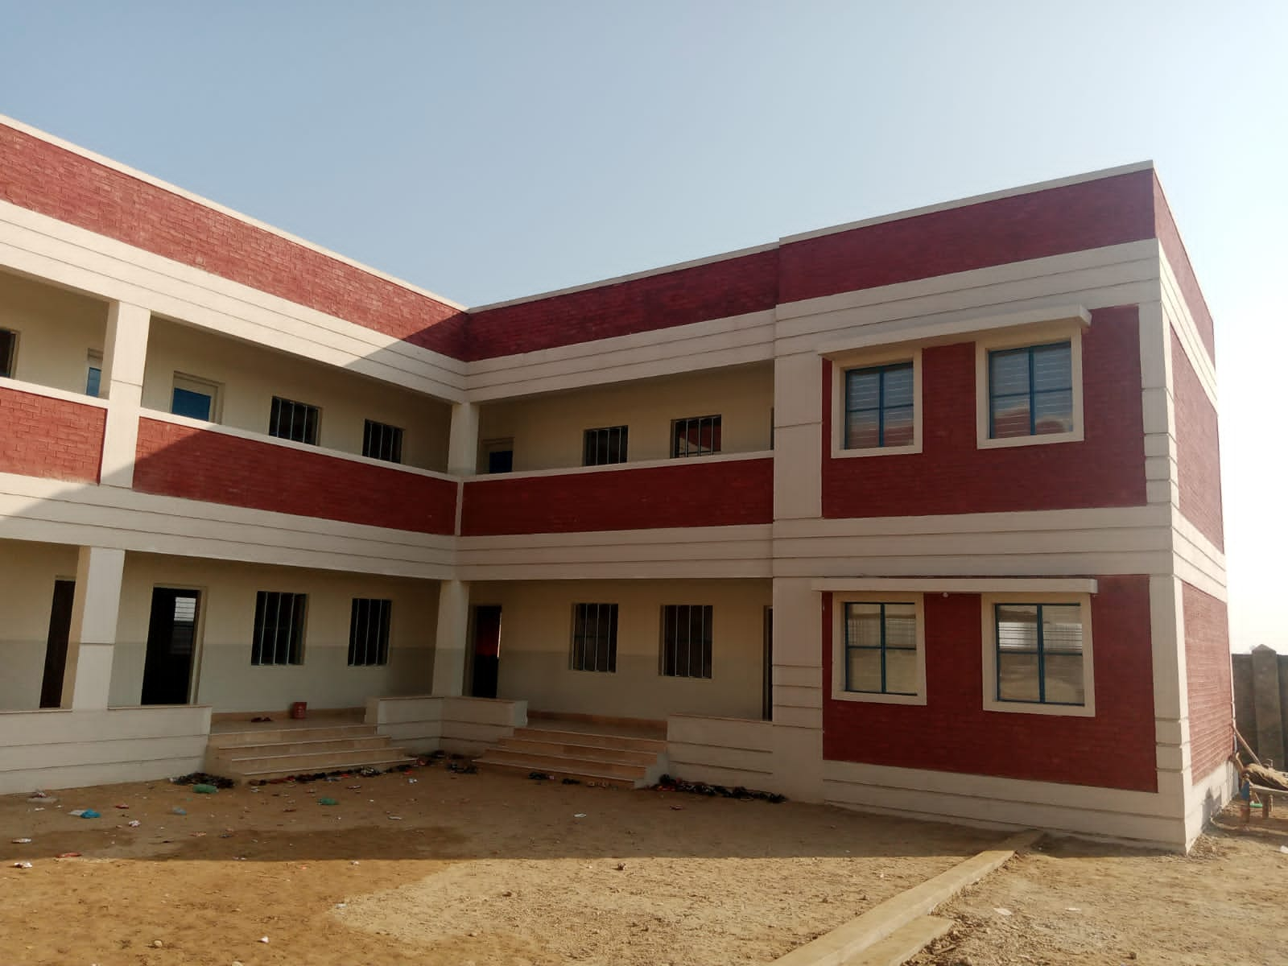
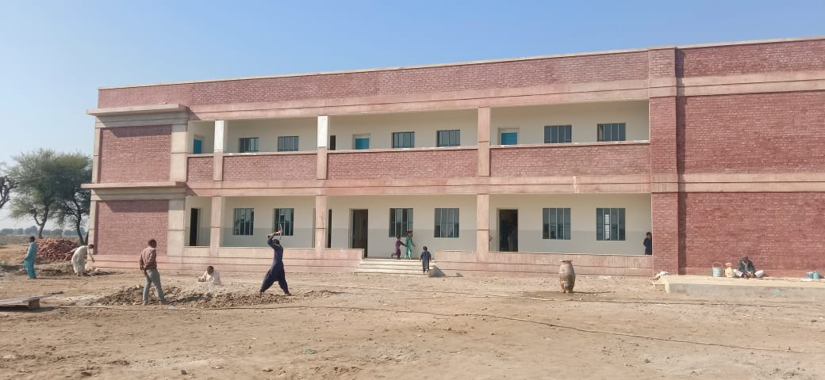
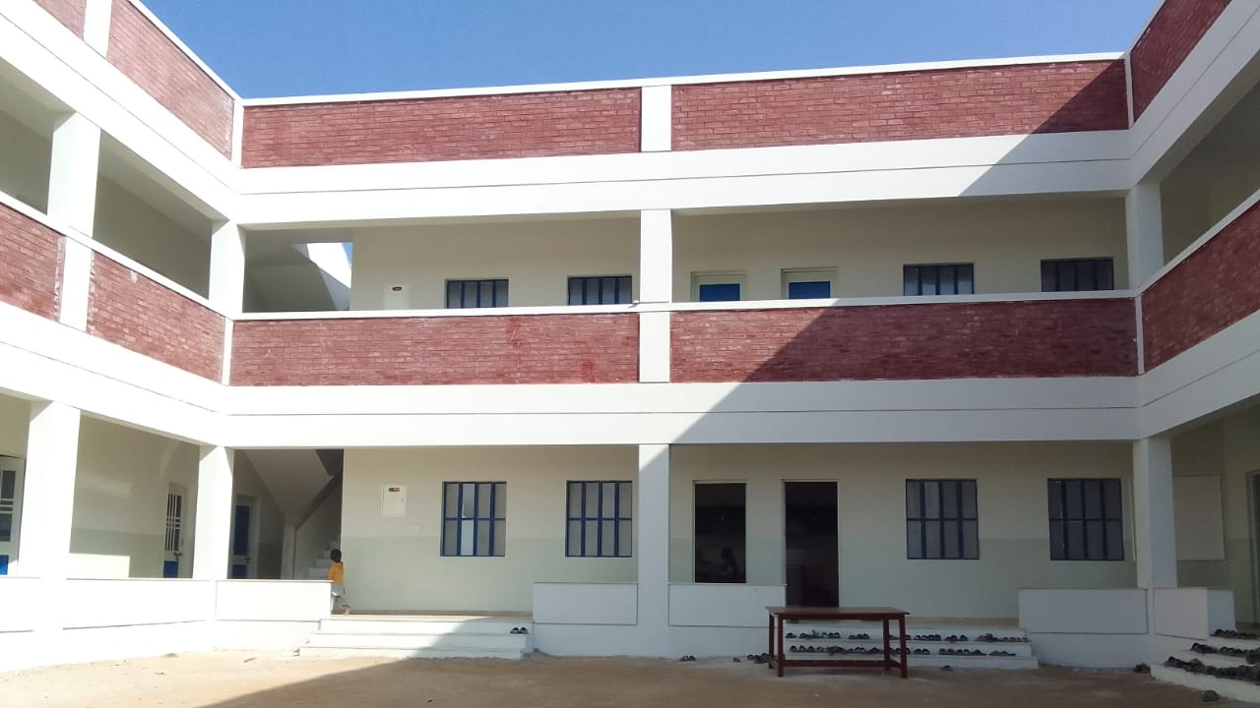
Foundation Assisted Schools (FAS) – A 10-year Public Private Partnership between The Citizens Foundation, and Sindh Education Foundation
Foundation Assisted Schools (FAS) – A 10 year Public Private Partnership between The Citizens Foundation, and Sindh Education Foundation (Pakistani Government)
About TCF
The Economist has called The Citizens Foundation (TCF) "perhaps the largest network of independently run schools in the world." Since 1996, TCF has developed a deep understanding of the issues at the heart of providing quality education in the most remote, underserved rural communities and urban slums in Pakistan. TCF currently runs over 1,921 school units with 286,000 students, including 405 partnership schools under TCF's Government Schools Partnership Program (GSP). With over 14,000 faculty and staff, TCF may be the largest private employer of women in Pakistan.
Background
TCF developed The Foundation Assisted Schools (FAS) model as a response to the challenges of school adoption as well as some of the broader complexities of scaling quality learning:
Capital for New Schools: Provincial governments lack the capital to fund new school construction while philanthropic grants may be easier for organizations like TCF to access.
Running Costs: Rapidly scaling fundraising for operational costs would be a much bigger challenge for TCF as compared to increasing the budget allocation for existing governmental PPP programs providing per-child subsidies.
Efficiency: TCF is able to build and operate schools at a lower cost than the government.
Learning Outcomes: With its tested model, TCF may be better placed to deliver higher quality learning outcomes that reassure grantors and deliver greater value for the taxpayer-funded subsidies sustaining school operations.

Slide 2
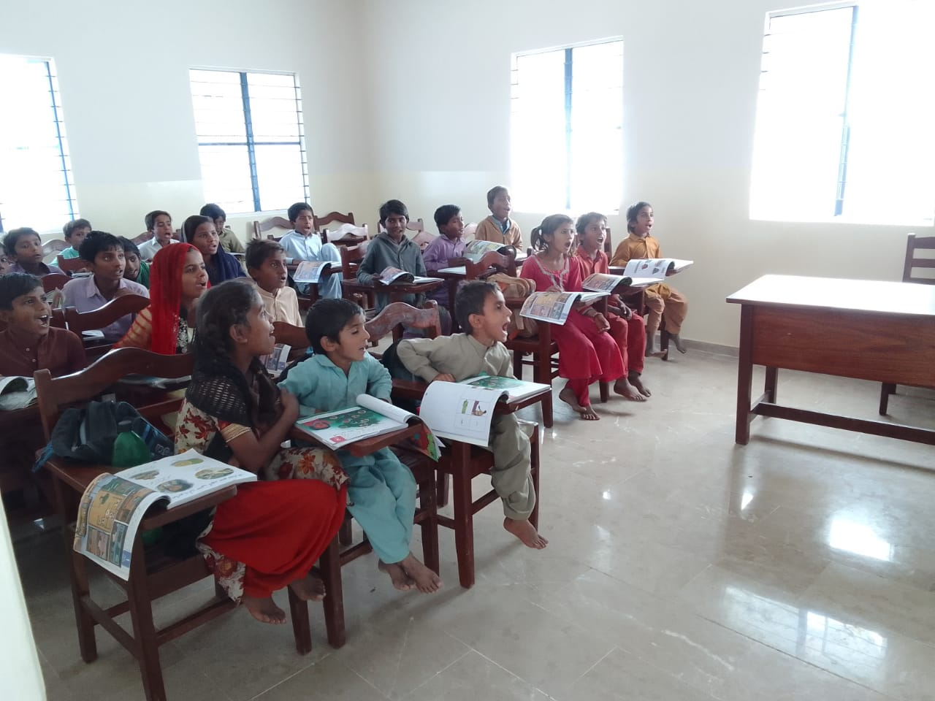
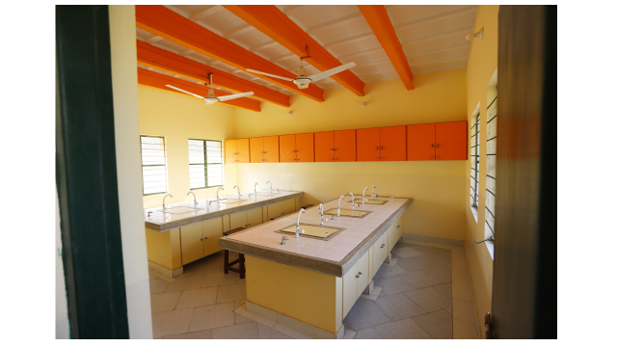
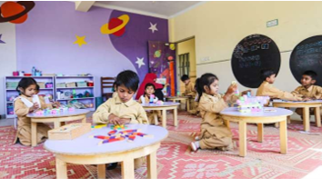
Project Specifics:
While majority of the campuses will have two school units (one primary and one secondary), some might have multiple units depending on the size of the location. Each school unit will have the capacity to enroll a total of 180 students. For primary units, the enrollment will be from Grades KG to 5, and for secondary units the enrollment will be from Grades 6 to 10.
Each school is purpose-built, with a boundary wall and all basic amenities including separate male and female toilets and running water. Each campus features a library with access to AV equipment and digital content, a science laboratory and a staff room. The school will have a female principal, 12 female teachers (1 per grade for KG to grade 10, 1 specialized English language teacher who works with all grades and 1 co-curricular assistant). Support staff includes 5 support staff (driver because teachers are transported, accounts assistant, guard, a maid and a cleaner).
The compound will also have a boundary wall, two separate toilet blocks for female and male students, and staff members, access to clean drinking water, and running water for sanitation and hygiene. TCF will also ensure that a secondary school is co-located with every primary school unit will help address the supply gap for secondary schooling, particularly for female students.
Early Years’ Program (EYP)
The newly built FAS schools will have some of TCF’s new interventions TCF has scaled across its flagship model. This includes an Early Years’ Program for Kindergarten to grade 2. To support a 21st-century play-based curriculum, TCF has built and designed vibrantly coloured rooms, child-level blackboards and shelves, age-appropriate roundtables and chairs and display and creativity boards that students can use. Floor seating is also encouraged as it allows for more flexibility in instructional approaches, as well as space for children to move around.
The curriculum includes learning through play, joyful storytelling, fitness through yoga and snack time. It aims to help children develop strong communication, language and socio-emotional skills that encourage children to think independently and critically and develop life skills.
The FAS model Is cost-effective as compared to the Flagship model as there is a vast difference in the cost of construction. The FAS model is a combined school with 1 primary and 1 secondary but in the flagship model primary and secondary are separate buildings which covers for the cost difference.

Slide 3
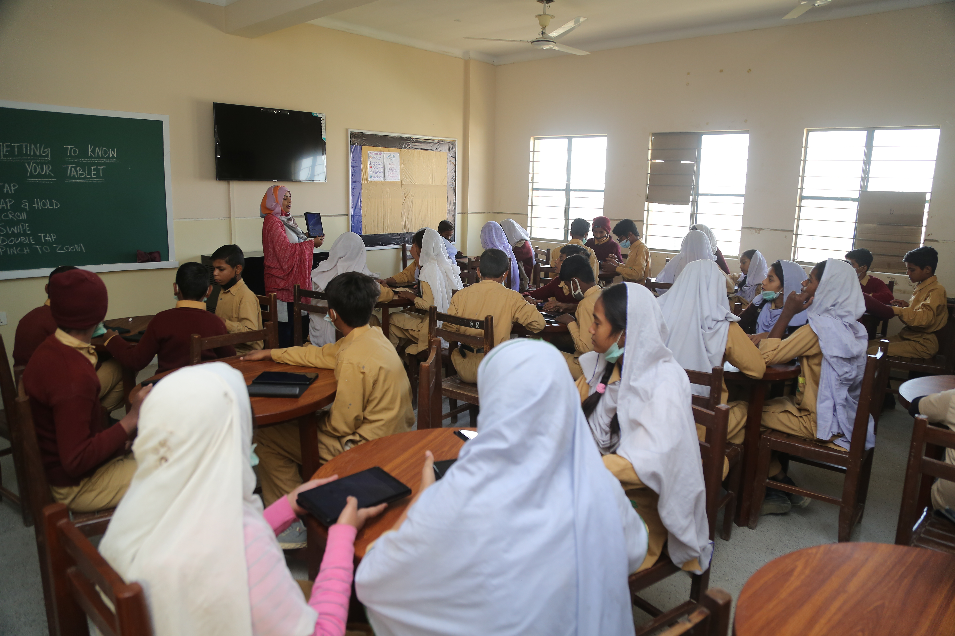
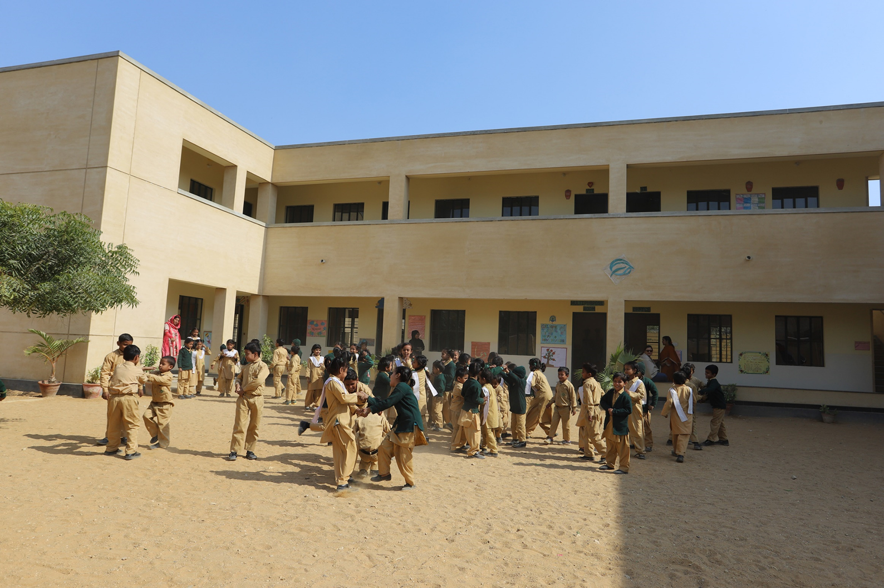
Solar
In an effort to move towards green energy, FAS units are now equipped with solar panels. Schools are often located in areas where infrastructure is poor and access to electricity is an issue. Moving towards sustainable energy will provide these schools with access to electricity and will allow for continuity of education. It will also help reduce TCF’s ecological footprint, save on increasing electricity costs and expose students to the benefits of clean energy.
Monitoring
FAS schools will benefit from TCF’s field management staff and systems. As with regular TCF schools, principals and teachers will go through consistent professional development. This will prime them to deliver quality education in alignment with TCF’s belief in whole-child-centred teaching and learning, premised on inquiry, collaboration and joy in the process of learning. Learning outcomes will be monitored through the administration of centralized tests. As TCF has seen with its existing adopted government schools, improvement in school quality drives sizeable increases in enrollment and learning, thereby increasing the number of students that can transition to higher education or jobs which have a higher earning potential. The progress of the FAS units will be shared on quarterly basis where not only several stages of the land acquisition and construction will be informed but also school operations will be discussed; including progress of students.
Objective of Project:
TCF currently administers 131 government school units in Sindh – 20 adopted through the Sindh Education Foundation (SEF), 38 through the Sindh Basic Education Program (SBEP), 6 through Pakistan Railways and 67 Foundation Assisted Schools.
TCF was able to operationalize 41 primary and secondary units in for academic cycle 2023-2024. These schools are located in communities which are significantly poorer and more underserved.
For the next academic cycle 2024-2025, the target is to operationalize 50 units both primary and secondary for which the relevant teams are working rigorously.
Funding Request
Keeping this momentum and pace, we would like to TCF is requesting USD 5 Million to establish 50 FAS units (25 primary and 25 secondary) in Sindh for the academic cycle 2026-2027.

