Slide 1
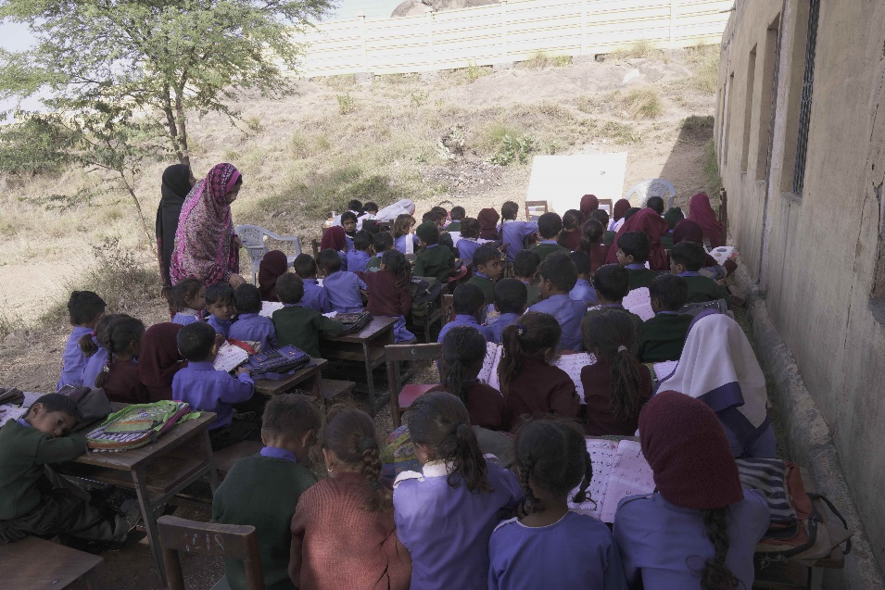
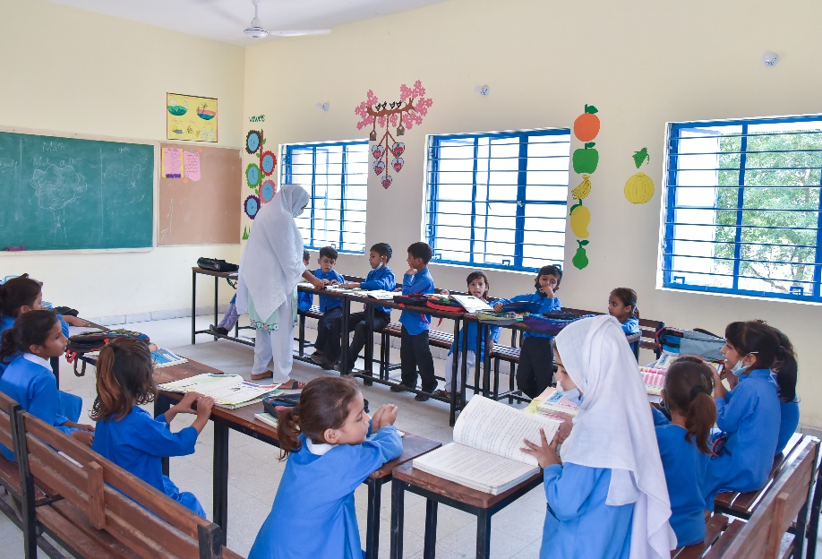
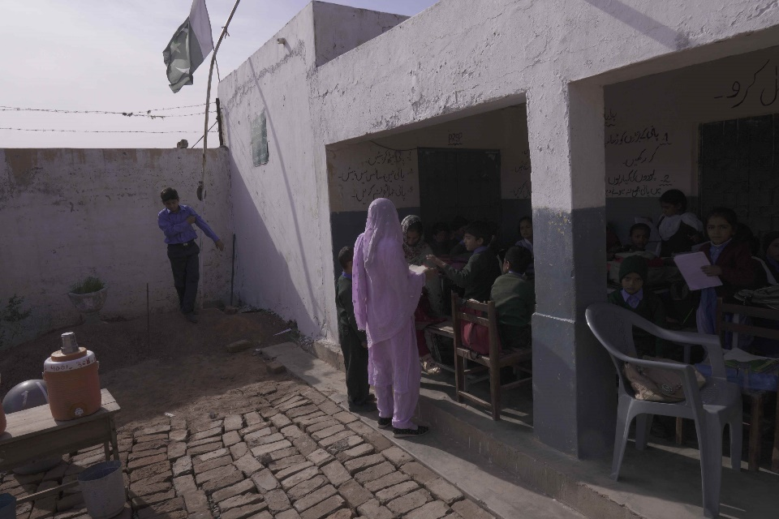
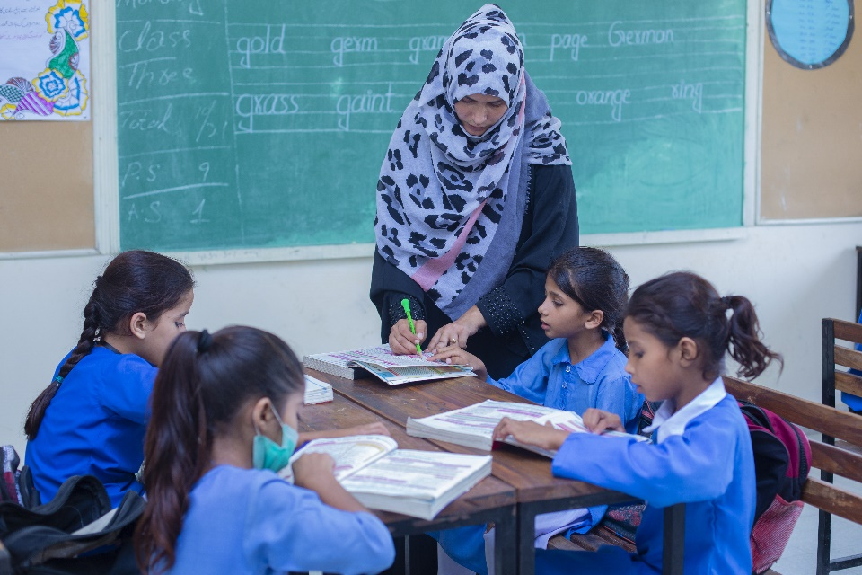
Partnership School in Punjab before additional room construction.
Partnership School in Punjab after additional room construction.
Enhancing Infrastructure in TCF's Partnership Schools in Punjab
To further its mission to provide quality education to less privileged children, TCF has adopted 383 government schools through public-private partnerships with provincial governments across Pakistan. TCF is improving the quality of these schools by building additional classrooms, and facilities and improving overall education quality.
Partnership School in Punjab before additional room construction.
Partnership School in Punjab after additional room construction.

Slide 2
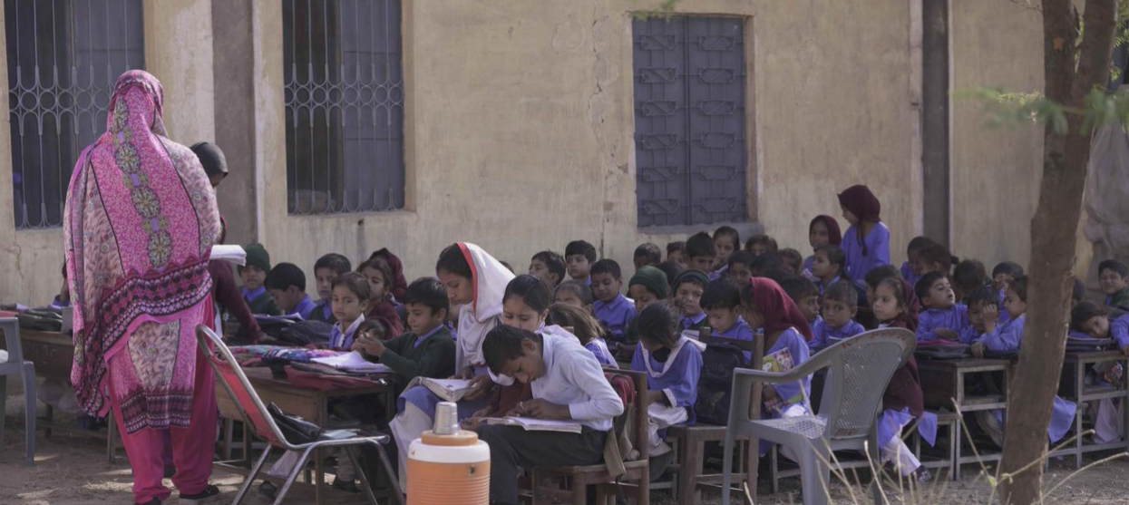
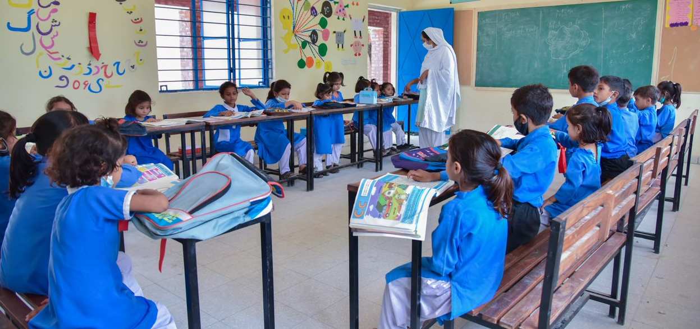
Enhancing Education Infrastructure under TCF’s Punjab Partnership Schools Program
Scaling the supply of quality government schools is part of TCF's 2030 strategy to magnify its impact by creating 2 million agents of positive change: well-rounded, motivated, and capable individuals who will not only be able to steer themselves and their families out of poverty but will also seek to improve the future of their communities and society at large.
Education infrastructure is important to support conducive learning environments. At TCF, our education model includes purpose-built schools with libraries and laboratories, literacy enriched-classrooms and well-trained teachers to facilitate meaningful learning.
In April 2016, TCF entered its first public partnership agreement with the provincial government of Punjab when it adopted 257 out of 4,000 of its worst-performing schools. These schools lacked basic infrastructure, had poor learning outcomes, low enrolment, high absenteeism, and gender inequality. The infrastructure and facilities available at these schools were inadequate to create an enabling learning environment for students. Most buildings had two to three rooms with little furniture, no playgrounds, toilets, or running water. The classrooms were overcrowded, forcing children to have classes outdoors.
TCF has made significant improvements to the infrastructure of these schools: building and painting classrooms, toilets and boundary walls, providing electricity and ensuring classrooms had adequate furniture and fans. In 2019, TCF built 600 additional classrooms in 191 government schools in Punjab that were overcrowded. Improvements to infrastructure were also made including the construction of pavements, 100 additional toilets, railings, and repairs to existing structures.
As a result of these improvements coupled with working on teacher quality and learning, the enrollment at these schools has tripled on average. TCF hired over 1,700 faculty and staff members and implemented its tested administrative and academic model, boosting learning outcomes. Second-grade literacy (ability to read a paragraph) went from 4% to 46% in the very first year.
This programme now involves 269 school units and 31000 students enrolled spread across 29 tehsils (sub-division of a district) of 6 districts in Punjab – namely Chakwal, Attock, Rawalpindi, Narowal, Kasur and Sargodha
Timelines and Funding Requirement
The components of this project entail building 75 additional classrooms and 75 additional toilets, constructing boundary walls, overhead sheds, installing ceiling and pedestal fans as well as painting old and new classrooms. It would also include any repair and maintenance work required to keep the building a safe learning space for children. The total cost of this project is USD 1,204,333 and will benefit around 31,000 students.
Total Project Cost
USD $1.2 million
Funds Requested
USD $100,000

Slide 3
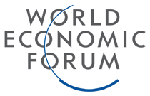
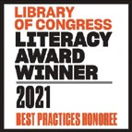
About TCF
The Citizens Foundation (TCF) is a movement to provide high quality schooling to the least privileged children in Pakistan.
TCF runs 1,833 school units that enroll 280,000 students. The Economist has called TCF "perhaps the largest network of independently run schools in the world." TCF may also be the largest private employer of women in Pakistan – in response to parental demand, we hire only women as faculty in our schools.
We leverage what we have learned through our own schooling system by providing direct operational support, advice, and books and training to government and low-fee private schools across Pakistan.
Recognition & Awards

