Slide 1
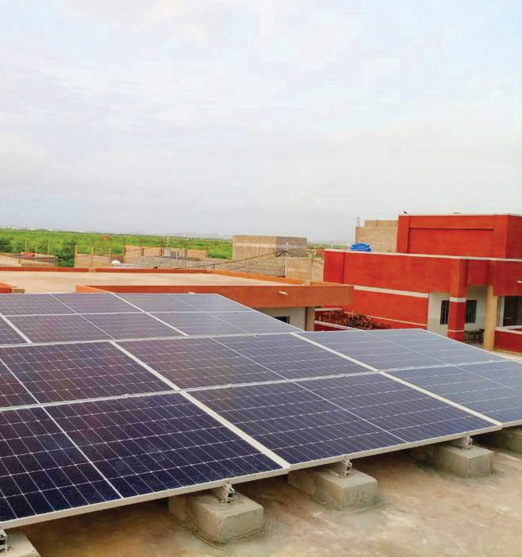
Promoting Green Energy
at TCF schools
To help tackle Pakistan's current energy crisis, TCF is working towards solar powering 105 schools which have limited access to electricity to ensure uninterrupted learning.

Slide 2
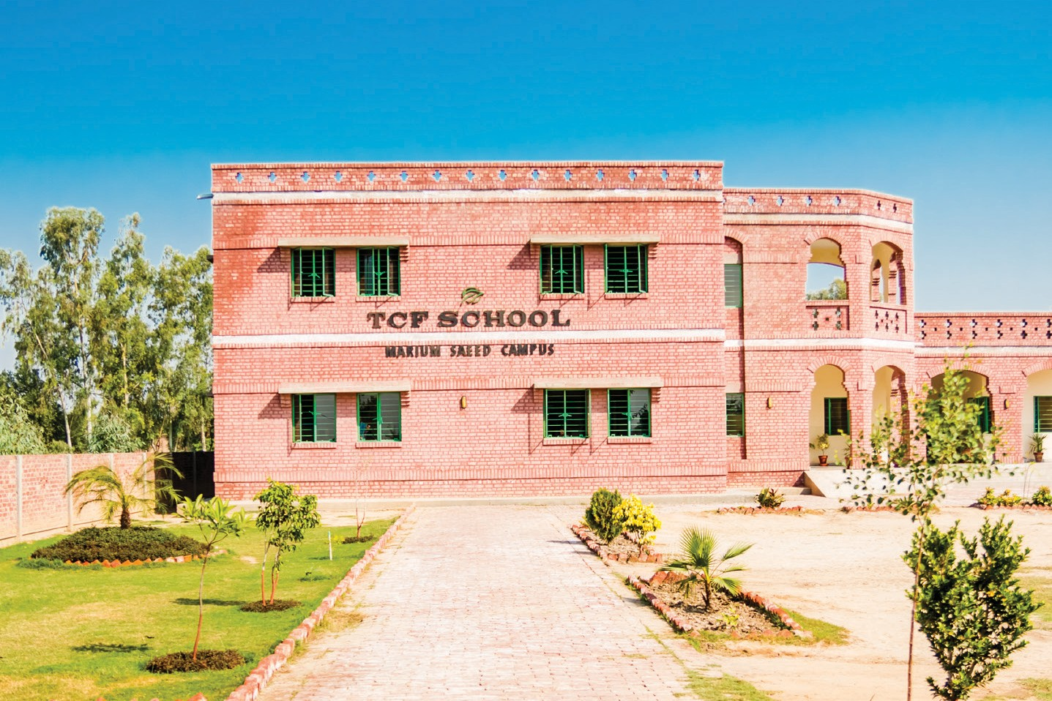
Installing Solar Panels in TCF Schools
TCF has 874 schools in Sindh, and in its capital city Karachi, one of the world’s largest megalopolis, with an estimated population of 20 million. A burgeoning population coupled with poor infrastructure and an energy crisis make delivering quality education a challenge, especially for a network like TCF that builds digital literacy through its curriculum and incorporates technology for learning. As TCF builds schools in urban slums and rural communities, access to electricity and running water is often a challenge.
TCF schools have a higher gender parity than the national average because parents know these schools are equipped with adequate facilities, making them safe spaces for children. This includes ensuring schools have an all-female faculty and a proper campus with boundary walls, running water, and toilets.
Timelines & Funding Requirements
The cost of installing one 8KW system solar panel is estimated to be around $10,500. The solar panel is assembled locally and has batteries for backup. The total funding requirement to solarize 105 school units is $1,050,000 which accumulates to 37,800 students. Costs of solar panels may vary due to inflation, reduction in subsidies to solar companies, and introduction of taxes.
Total Project Cost
USD $1.0 million
Funds Requested
USD $105,000

Slide 3
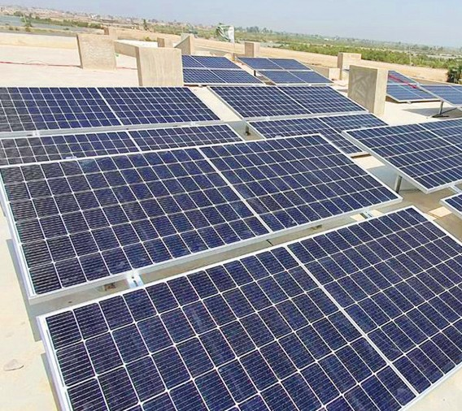
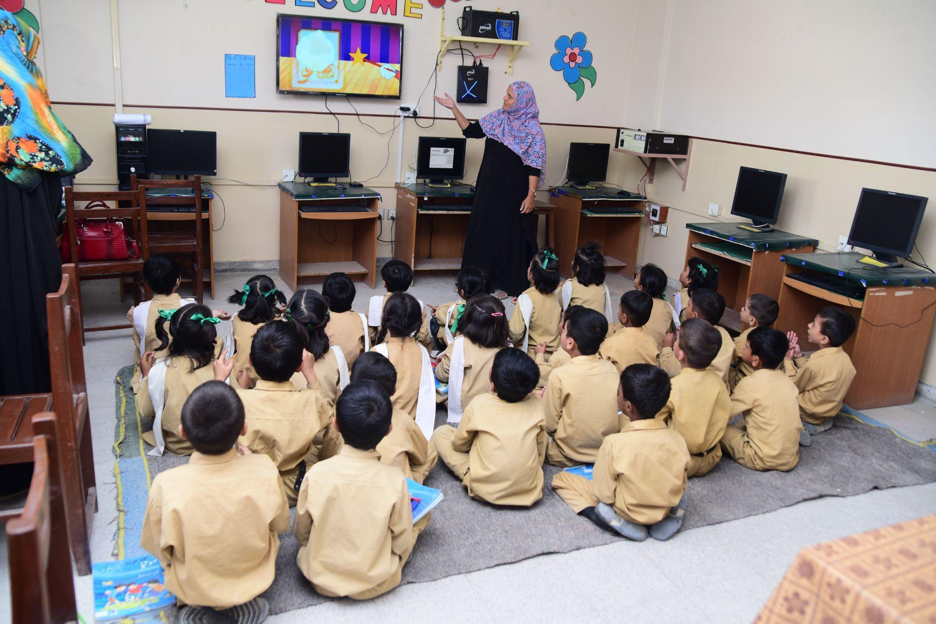
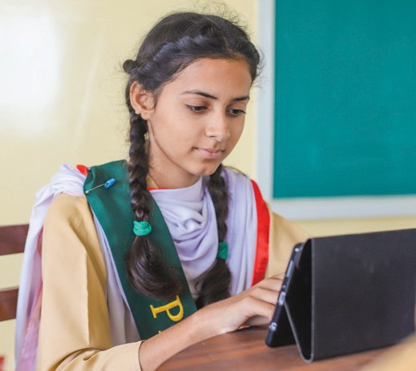
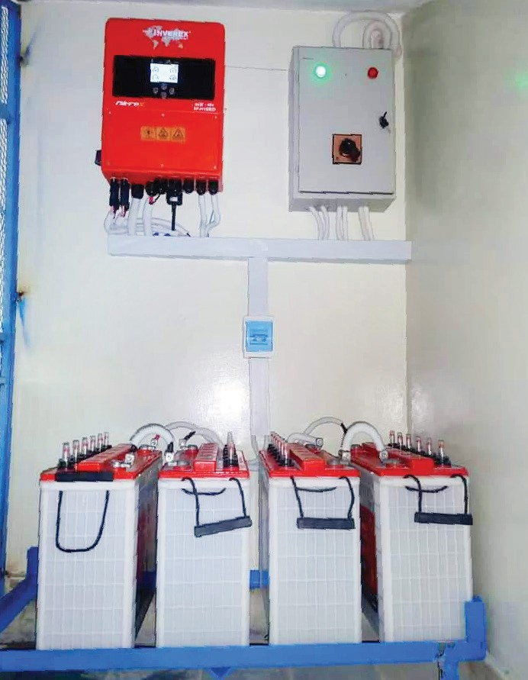
Why is it important to move to Solar Energy?
Reducing our carbon footprint
TCF has identified 105 schools in Sindh that have no electricity or are suffering from long power outages and would benefit from solar powered energy. Moving towards sustainable energy will provide these TCF schools with access to electricity and will allow for continuity of education. It will also help reduce TCF’s ecological footprint, save on increasing electricity costs and expose students to the benefits of clean energy.
Power outages
Lack of electricity makes learning exponentially difficult for students in summers with no fans and causes hygiene issues with no running water in bathrooms.
Digital learning
Through the installation of solar panels, TCF will ensure that schools have the required infrastructure and that students have access to digital learning resources to build 21st-century digital skills, which includes having access to audio-visual content and digital aids for both students and teachers.
Monitoring and maintenance
Monitoring and maintenance of these solar panels will be managed by TCF’s engineering department, who will conduct frequent visits to ensure the panels are operational and working efficiently. The payments are released to contractors once the monitoring team verifies that the panels have been installed according to the defined terms and conditions of the agreement. The engineering department will be responsible for the maintenance of the solar panel system and the vendors also make maintenance visits. It takes approximately 12 weeks to install solar panels in schools from vetting vendors and receiving quotations to finalizing vendors and solar panel installation.

Slide 4
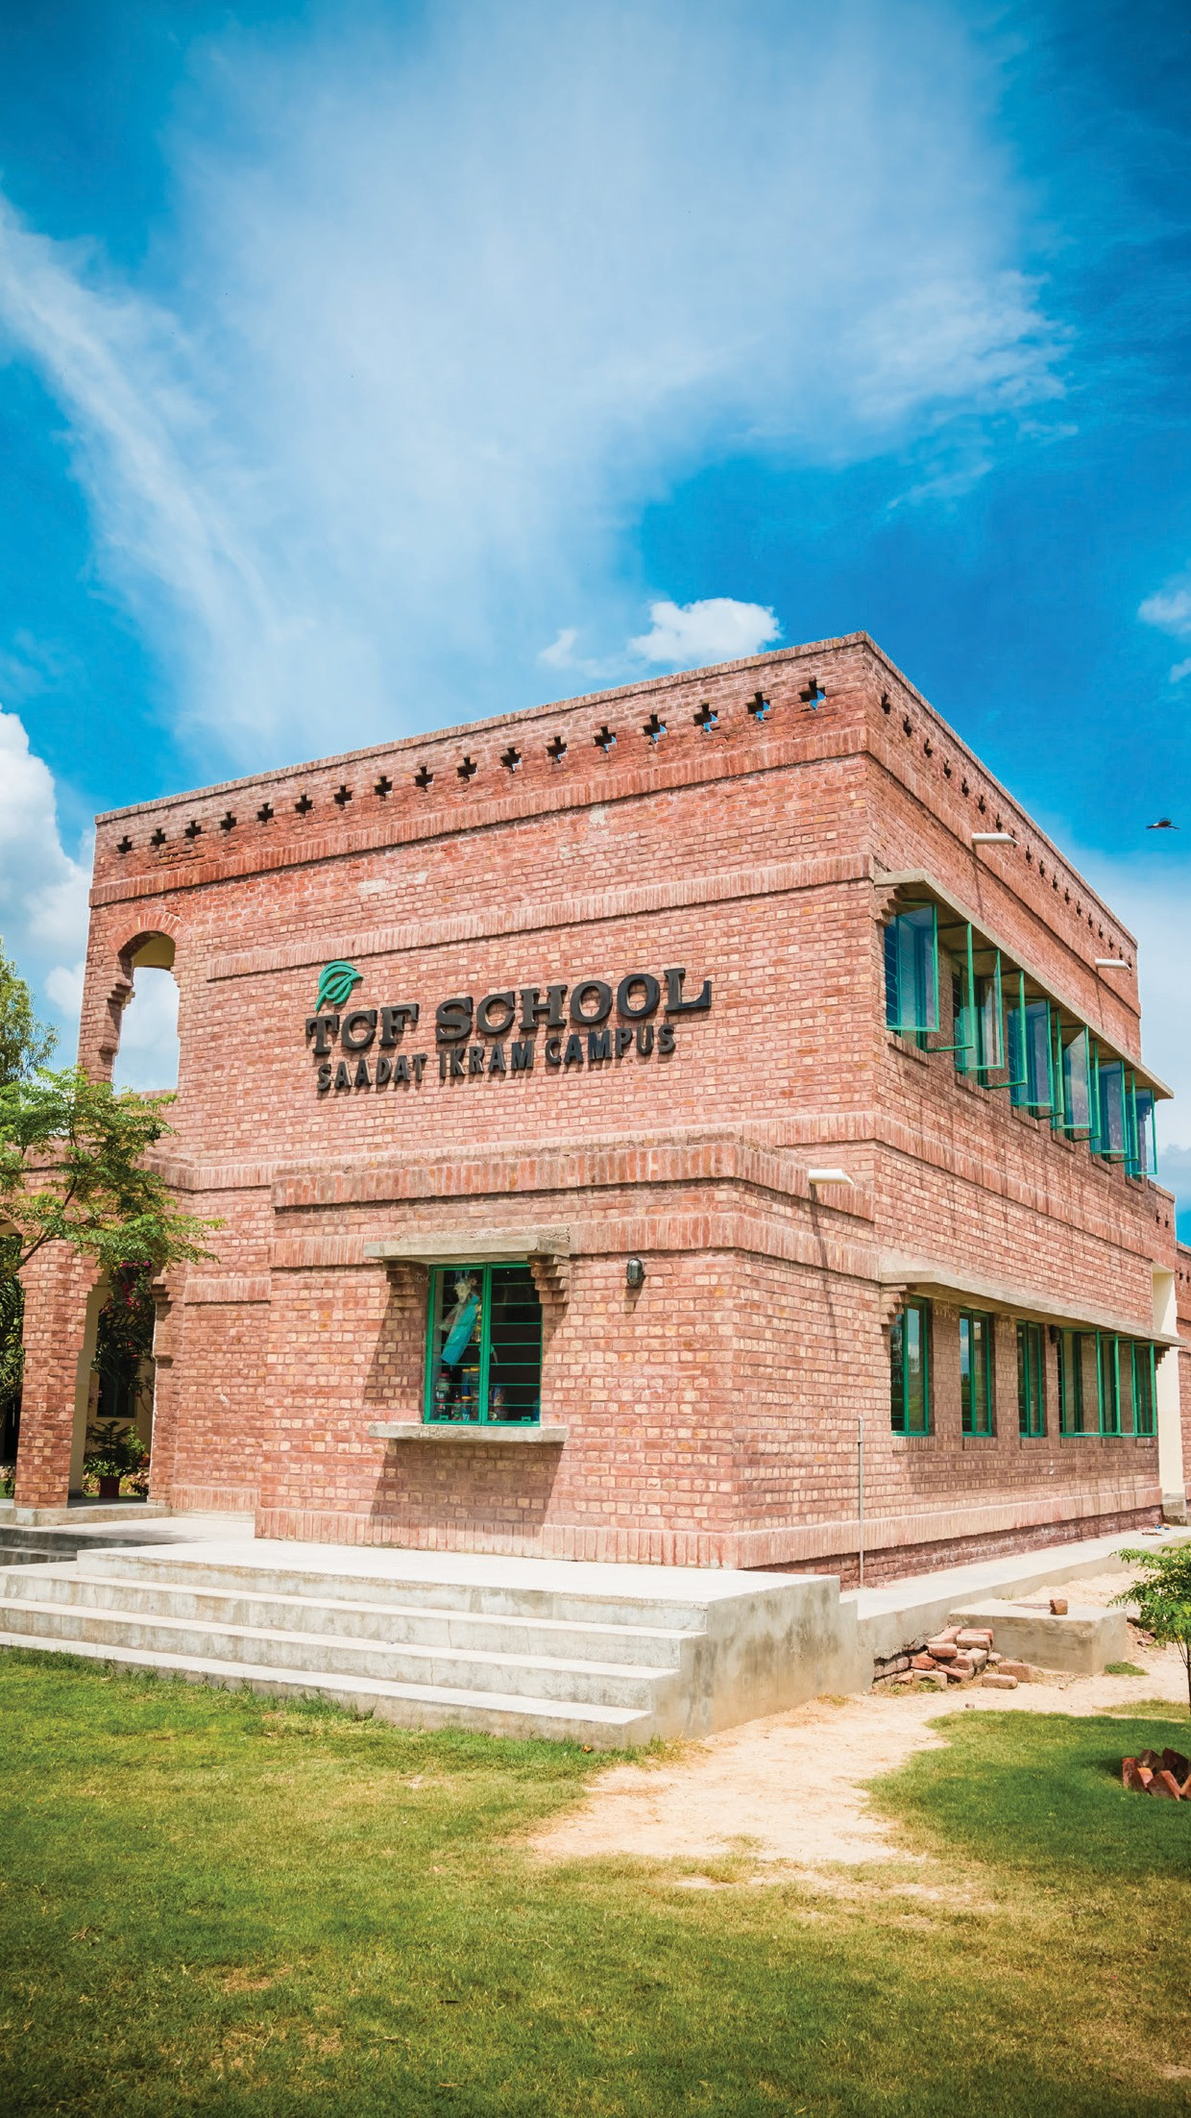
About TCF
The Citizens Foundation (TCF) is a movement to provide high quality education to the less privileged children in Pakistan. TCF runs 1,833 school units that enroll 280,000 students. The Economist has called TCF "perhaps the largest network of independently run schools in the world." TCF may also be the largest private employer of women in Pakistan – in response to parental demand, we hire only women as faculty in our schools.
We leverage what we have learned through our own schooling system by providing direct operational support, advice, and books and training to government and low-fee private schools across Pakistan.
Recognition & Awards

