Slide 1
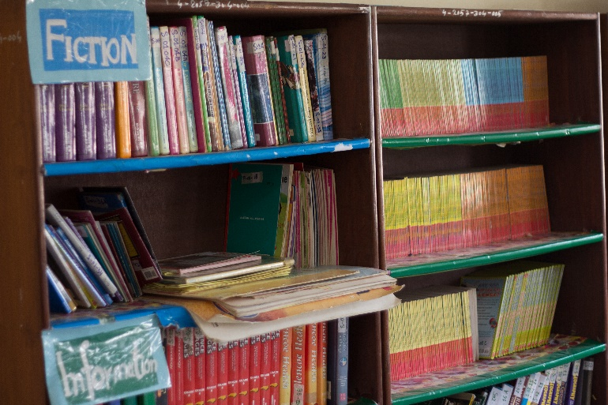
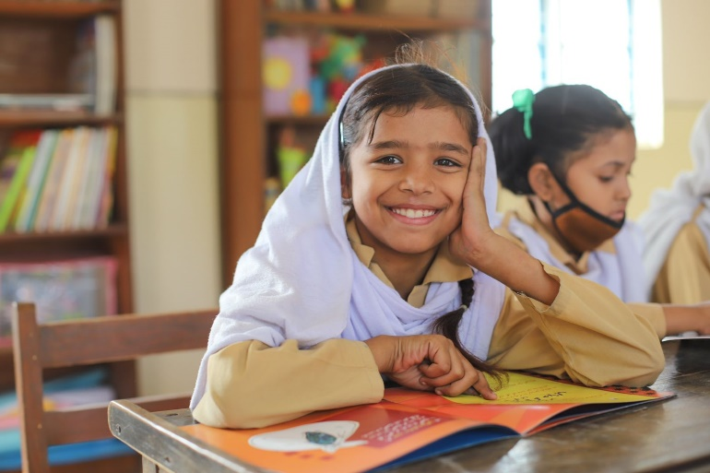
Revamping Libraries across the TCF Network
Foundation Assisted Schools (FAS) – A 10 year Public Private Partnership between The Citizens Foundation, and Sindh Education Foundation (Pakistani Government)
About TCF
The Economist has called The Citizens Foundation (TCF) "perhaps the largest network of independently run schools in the world." Since 1996, TCF has developed a deep understanding of the issues at the heart of providing quality education in the most remote, underserved rural communities and urban slums in Pakistan. TCF currently runs over 1,911 school units with 280,000 students, including 405 partnership schools under TCF's Government Schools Partnership Program (GSP). With over 14,000 faculty and staff, TCF may be the largest private employer of women in Pakistan.
Context
In Pakistan, library periods are seen as a free period when children can play or teachers can use to teach other subjects. Books – even those provided by donors like USAID – can be found locked behind glass so that children cannot steal or damage the books. Students are not trusted to take them home. It is also a challenge to find books that young readers would enjoy written in the local languages that they understand. In many countries, there is a dearth of local language picture books that help cultivate a joy of reading in the youngest children. TCF has nearly 1,200 libraries in its schools across Pakistan. We recently conducted focus group discussions with students, teachers, principals, parents, and alumni. 32% of student participants said they had no opportunity to visit the library during the school week. Amongst teachers, only 22% of participants said that their schools utilized libraries at the scheduled time or during story-time for students, the remaining 78% of participants stated that libraries were either used as AV rooms, staff rooms or working rooms during their free time. In addition, teachers and students lamented the absence of diverse reading materials in nearby bookstores, which predominantly offer course-related books.

Slide 2
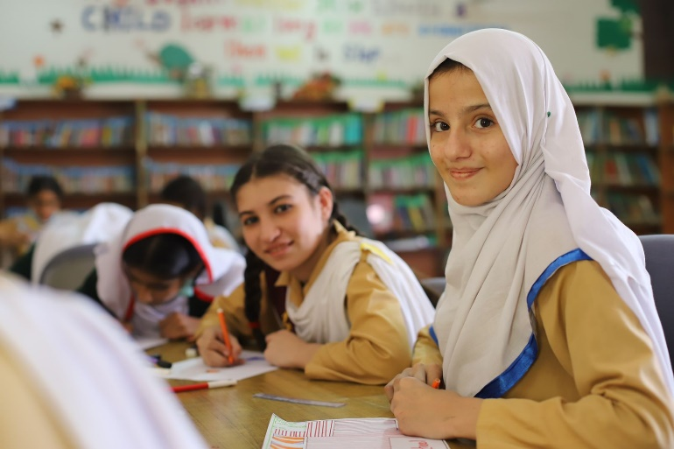
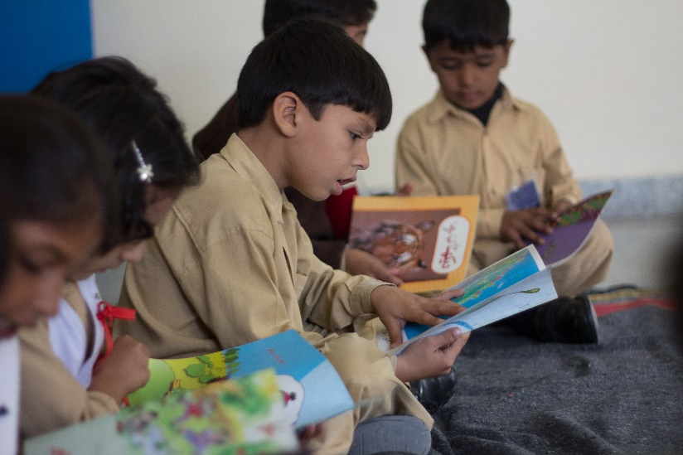
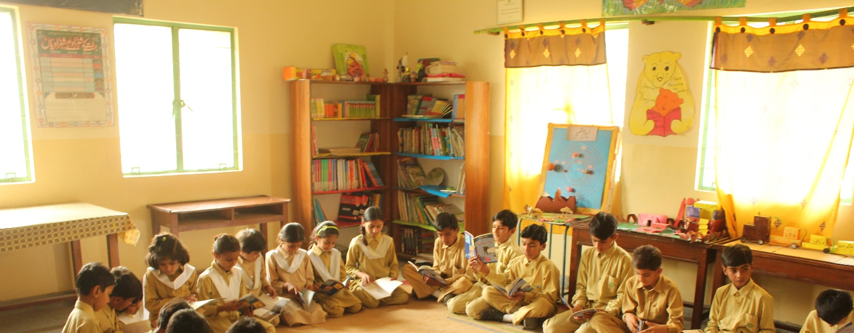
Project Deliverables:
To contribute significantly to the overarching goal of library transformation and to foster a love for reading, the TCF Libraries Project will focus on the following deliverables:
1. New Book List for Primary and Secondary Schools:
A carefully curated booklist designed to cater to the unique needs and interests of students in different age brackets with a diverse range of genres, spanning from educational support materials to engaging leisure reading. The number of available titles will also be expanded from around 140 to 250 in primary schools and from around 150 to over 300 in secondary schools.
2. New Library Policy:
TCF is introducing a new library policy to enhance its library's appeal to students. This policy includes reinforcing rules through staff training and ensuring uninterrupted access to the library throughout the school day. Students are empowered to borrow two books for a week, and the library is divided into zones to cater to different reading preferences. Additionally, students are encouraged to take ownership of the library by participating in maintenance and book repair activities. The policy also extends library privileges to teachers and parents, supported by training modules.
3. Investing in Library Equipment/Furniture:
Designation of a dedicated classroom for library shelf placement in schools without existing library rooms, with careful adjustment of timetables to accommodate library use. This will be supported by procurement of suitable shelves to enhance the functionality of schools where there are no libraries.
4. Replenishment Process Development:
Establishment of a systematic replenishment process, in collaboration with the supply chain department, to ensure that library books are regularly refreshed and replaced consistently and promptly.

Slide 3
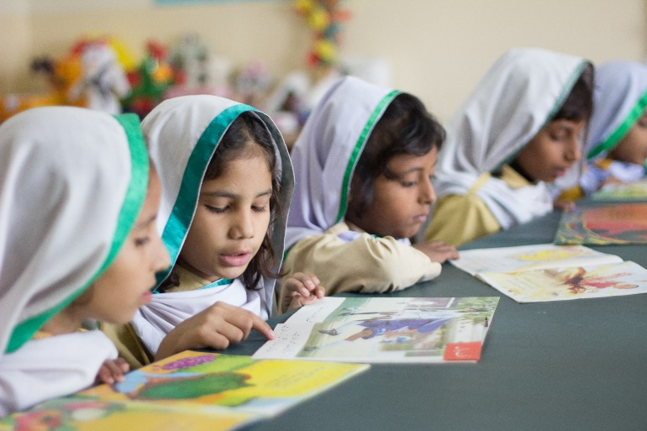
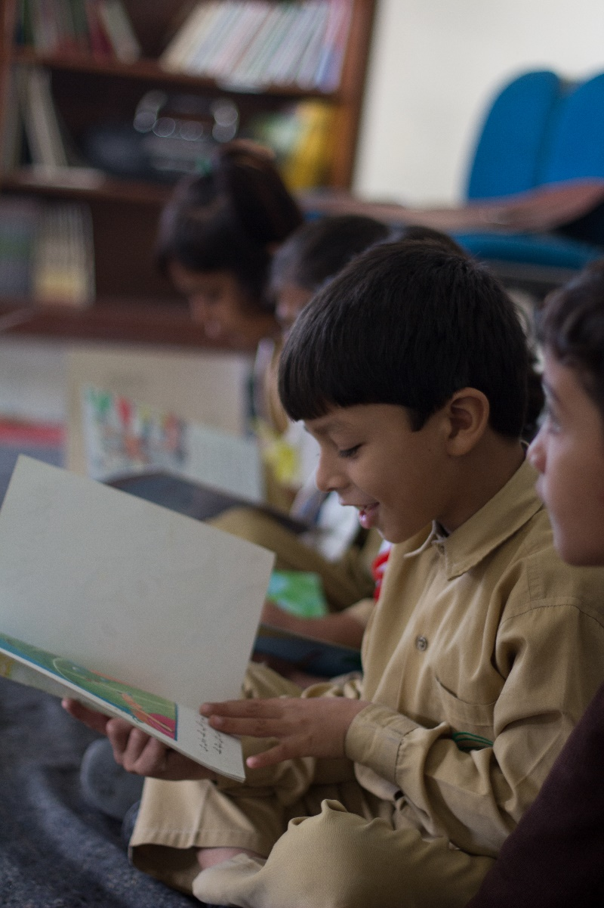
Objective of Project:
Through the Libraries program TCF aims to:
Actively lend books to students and their parents. TCF will involve parents in the lending program so that they can help students return books on time. In case a book is damaged, the librarian or staff member in charge of the library will work together with the student to repair it.
Roll out a new library period where students engage in self-directed exploration. During the library period, students might read on their own or with a teacher, have story-time, learn to find books with a teachers’ help, discuss books they are reading, or do creative activities such as drawing or writing. TCF will train teachers to support and facilitate these activities without forcing students to do a certain activity.
Funding Request:
The cost of replenishing and revamping one library is estimated at $2,000/-.
Currently, TCF aims to revamp a total of 1,192 libraries across its network.
The total funding requirement to revamp 1,192 libraries is $2.3 million.
Minimum donations of $100,000/- will be accepted for the program which will fund 50 libraries.
Stock libraries with joyful, interesting, and age-appropriate books with an emphasis on local language materials which are hard to find especially for the early years. To instill a love of reading, we must stock libraries with books that interest children.
Re-design the library space. There will be three zones: one of reading, a second for discussions or storytime, and a third for arts and crafts related to books. Moreover, where library space is not available, we will procure and provide bookshelves.
We believe that libraries are key to transform students’ academic outcomes, socio-emotional skills, and even life outcomes. The project demonstrates how joyful, student-directed learning can strengthen literacy and learning in a country where over half of third graders cannot read.
The program will directly impact 286,000 students and 14,000 school faculty members across the TCF network.

