Slide 1
School
Support Proposal
Head Office: Plot No. 20, Sector – 14, Korangi Industrial Area,
Karachi | UAN No.: +92-21-111-823-823
Website: www.tcf.org.pk I Email: isfandyar.inayat@tcf.org.pk Pakistan Registered Charity No. 0037144 | Company No. K- 06597

Slide 2
About TCF
The Citizens Foundation (TCF) is a movement to provide high quality schooling to the least privileged children in Pakistan.
TCF runs over 1,921 school units that enroll 286,000 students. The Economist has called TCF "perhaps the largest network of independently run schools in the world." TCF may also be the largest private employer of women in Pakistan – in response to parental demand, we hire only women as faculty in our schools.
We leverage what we have learned through our own schooling system by providing direct operational support, advice, and books and training to government and low-fee private schools across Pakistan.

Slide 3
OPERATIONAL SUPPORT REQUESTED
For the academic year [2024-25], annual operational cost of supporting one TCF school is estimated to be PKR 6,500,000. All TCF Schools have a pay-as-you-can-afford system, where families are encouraged to make a nominal contribution towards the fee based on their means – often as little as PKR 10 . The shortfall is funded by the well-wishers such as yourself.
Funding Requirement
Support Cost | Fund Requested (PKR)
School | 6,500,000

Slide 4
OUR IMPACT 2023-24
1,921
purpose-built
school units
286,000
students from low
income families
14,000
principals and
teachers
57,000
matriculates
till date
90%
pass rate for
matriculates
83%
student transition to
Intermediate education
174,000
Aagahi Literacy
Programme beneficiaries
till date
3,200
Vocational Training
Programme beneficiaries
48,000
Clean water project
beneficiaries per day
(Impact Numbers as of 2023-24)

Slide 5
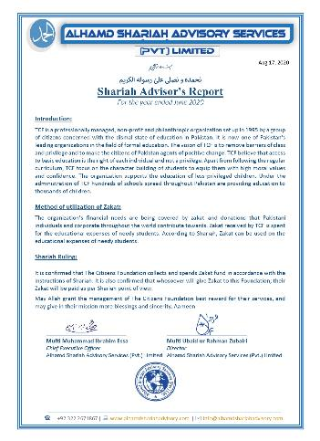
TCF’s SHARIAH CERTIFICATE
TCF follows the 'Wakala' model of Zakat where the parents of deserving students nominate TCF as a 'Wakil' (agent) and authorize the organization to receive Zakat on their behalf, to be spent on their children's educational expense.
All proceeds collected by TCF as Zakat are maintained in a separate Islamic banking account used specifically for this purpose. The funds are then utilized through the course of the year on certain pre-approved operational expenses. Every quarter, TCF’s Shariah advisor performs a thorough review of Zakat expenses to ensure that Zakat is being applied correctly.

