Slide 1
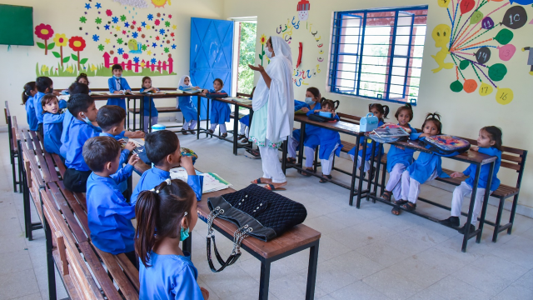
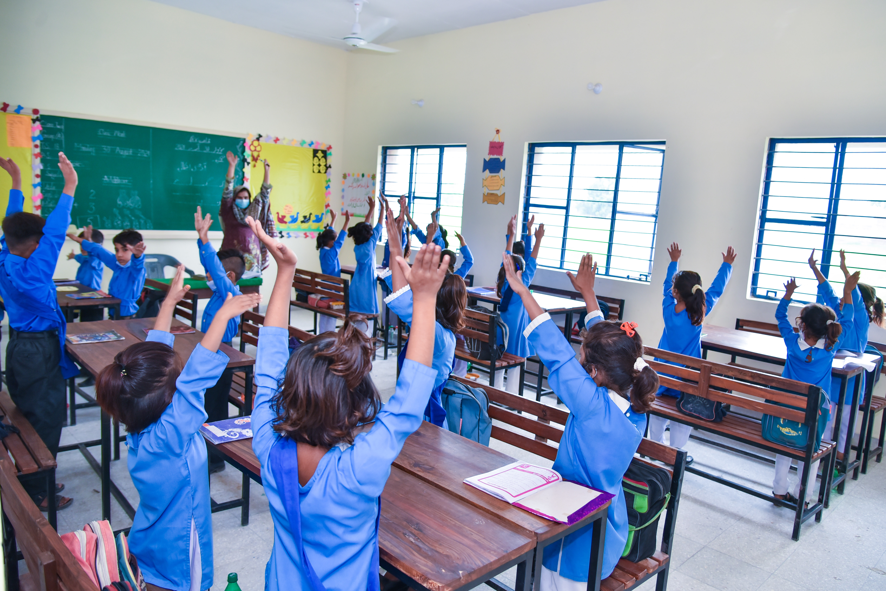
Supporting TCF's Partnership School Programme
About TCF
The Economist has called The Citizens Foundation (TCF) "perhaps the largest network of independently run schools in the world." Since 1996, TCF has developed a deep understanding of the issues at the heart of providing quality education in the most remote, underserved rural communities and urban slums in Pakistan. TCF currently runs over 1,833 school units with 280,000 students, including 352 partnership schools under TCF's Government Schools Partnership Program (GSP). With over 13,000 faculty and staff, TCF may be the largest private employer of women in Pakistan.
Background- TCF’s Partnership Schools Program
In April 2016, TCF entered its first public partnership agreement when the Punjab provincial government in Pakistan put its worst performing schools up for “adoption” by the private sector. TCF won the management rights for 257 schools in Punjab and since then, TCF has signed multiple public-private partnership agreements with provincial governments and now runs 352 partnership school units.
The government schools in Punjab were two room, unfurnished buildings that lacked basic infrastructure, had low enrolment, poor learning outcomes, high absenteeism, and low gender parity. TCF has not only worked towards improving quality of education in these schools but has also improved infrastructure. Within the first year of taking over, TCF increased enrolments from 7,000 to 27,000 students and improved student success rate in Grade five examinations from 10% to 72%. TCF hired over 1,700 faculty and staff members and implemented its tested administrative and academic model, boosting learning outcomes. Enrollment tripled and 2nd grade literacy (ability to read a paragraph) went from 4% to 46% in the very first year.
TCF has made significant improvements to the infrastructure of these schools: building classrooms, toilets and boundary walls, providing electricity and adequate furniture in the classrooms including installing pedestal and ceiling fans, and painting classrooms.
Apart from infrastructure, TCF has also been working on improving the quality of education through developing teachers, faculty and students. Drawing from best international practices, TCF has a dedicated team that works on developing teacher and principal training content, including supplementary material to support the government curriculum. Faculty goes through mandatory trainings every year, based on the organization's extensive experience in developing teacher training modules.
​
Since 2016, 48,500 children from disadvantaged communities have been provided free quality education, of whom 48% are girls. 2,100 principals and teachers while 700 non-faculty staff have been given employment in the schools.​
​

Slide 2
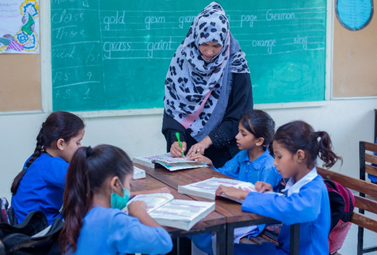
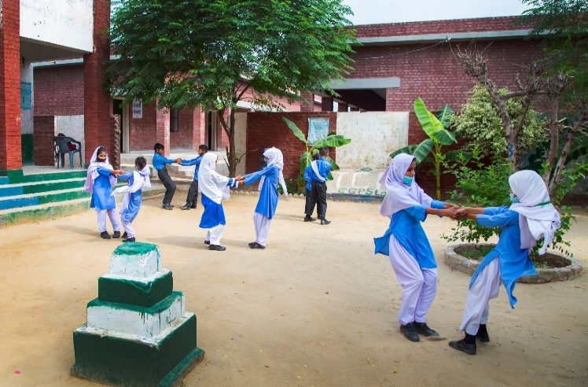
TCF currently administers 352 schools in the partnership programme – 269 adopted through Punjab Education Foundation, 20 through the Sindh Education Foundation (SEF), 39 through the Sindh Basic Education Program (SBEP), 6 through Pakistan Railways and 18 Foundation Assisted Schools.
As part of efforts to strengthen learning outcomes in schools, the Programme Design team has been involved with the implementation of various quality interventions. These included
Whole School Remediation
To mitigate the learning losses caused by the pandemic, TCF introduced a whole school remediation program called Aghaz, in 2021, which focuses on literacy, numeracy and Urdu. Teachers were provided with diagnostic tools to assess the current learning levels of their students, and based on this, employ material designed by the academic team for the first six to eight weeks of the academic year. This helps students reinforce key concepts of the previous year.
Student Development Framework
This includes introducing classes that build cognitive and socio-emotional skills, such as story period and “choice” time, where early-year students get to play with curated toys. One of the initiatives developed and introduced this year was an end-of-school capstone programme for Grade 5 students. Students are guided through a curriculum taught through workshops, facilitated by the teacher on identifying challenges afflicting their school or community, brainstorming ideas and then implementing solutions .
Staff Development
TCF has introduced its professional development model in partnerships schools. Teachers are now required to go through mandatory training every year and are also provided guidance through teacher guides and audio and visual aids. This year, Principal Academy has been introduced which aims to build school leaders and focuses on leadership, team building, communication skills, and motivation.
These interventions contribute towards improving the quality of the education in these schools in terms of both curriculum and teaching.
The subsidies paid by provincial governments is important to support learning-conducive environments. It is estimated that if we combine the subsidy by both provincial governments (Punjab & Sindh), TCF receives a subsidy 539 PKR per child per month on average, covering 36% of the cost. The subsidy is not fixed and varies upon students' performance on examinations, faculty's performance on evaluations and facilities operational in these schools. It also varies under the different partnerships that TCF has with different stakeholders that are operating under this programme. The remaining cost is borne by unrestricted donations to TCF.
Funding Requirements
The overall budget for the 352 partnerships schools' units in Punjab and Sindh is USD 3.7 Million. The total operational deficit for schools is USD 2.4 Million which consists of salaries, repair and maintenance expense, program overheads, utilities and other miscellaneous expense)

