Slide 1
Welcome to the TCF Family

Slide 2
Pakistan is facing an acute learning crisis
44% (22.8 million) of children of school-going age in Pakistan are out of school; 54% are girls and 46% are boys
Children from low-income families are 6 times more likely to be out of school than children from richer families
45% of children with 5 years of schooling cannot read a grade 2 level story in Urdu (local language
There are an average of only 2.7 teachers per Govt. school where the typical primary school has 6 grades
Around 25% of Govt. primary schools have no bathroom or even a boundary wall
Source: https://www.unicef.org/pakistan/education
Notes:
Pakistan is facing an acute learning crisis
We are facing a monumental educational crisis in Pakistan, with 22.8 million children of school-going age currently out of school. 45% are unable to read a grade 2 level story in Urdu even after five years of schooling.
Low-income families bear the brunt, as their children are six times more likely to be excluded from education. This crisis stems from limited access to quality education, which is usually hampered by income, gender, and geographical disparities.

Slide 3
Out of every 10 Pakistani children of school-going age …
4 children
remain out of school
3 children
are in school but not learning
And only 3 children
are in school and learning at their grade level
Because access to quality education is hampered by income, gender, and geography
Notes:
The scale of this challenge surpasses any single institution, even the government, to resolve quickly.
Out of every 10 children reaching school-going age in Pakistan
Access to quality education is hampered by income, gender, and geography
I’d like to welcome you to an organization that has committed itself to being part of the solution. And before you go ahead with your role as a significant member of TCF, let’s rewind and see what sparked this movement in the first place.

Slide 4
From 5 schools and 800 children
Notes:
In 1995, six friends decided to bring about a social change in Pakistan. They decided that education is the key to resolving multiple societal issues such as health, poverty, unavailability of microfinance, and unemployment.
They took the initiative to build 5 schools with their own funds. What started as a goal to establish 1000 schools in the most underprivileged areas, has now grown into a global collaborative movement driven by the need to eradicate illiteracy, ignorance, and inaccessibility of quality education across Pakistan.

Slide 5
1,921
purpose-built
school units
286,000
students from low
income families
14,000
principals and
teachers
57,000
matriculates
till date
90%
pass rate for
matriculates
83%
student transition to
Intermediate education
174,000
Aagahi Literacy
Programme beneficiaries
till date
3,200
Vocational Training
Programme beneficiaries
48,000
Clean water project
beneficiaries per day
(Impact Numbers as of 2023-24)
Notes:
So, are we succeeding? Are we making the impact that we had envisioned? Yes! Alhamdulillah, we are making a massive impact on millions of lives.
TCF is one of the world’s largest networks of formal schools for the less privileged and it is scaling faster with time. The first 500 schools were established in 12 years, the next 500 in 7 years and the last 921 in 9 years. As of today, we have 1,921 school units operating across Pakistan.
90% of TCF students have passed their Grade 10 matriculation examinations and 30% have achieved A1 or A grades. Considering that these are our first FBISE results, they compare well with overall results for all students appearing in FBISE exams.

Slide 6
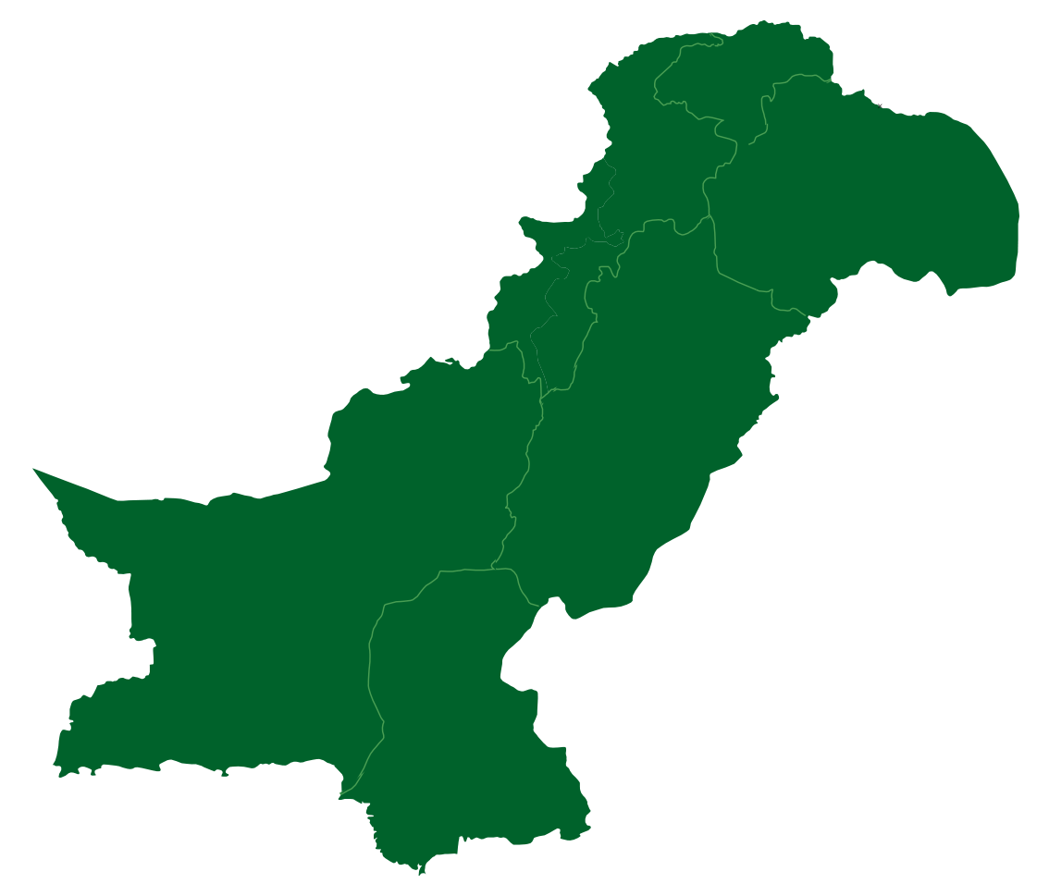
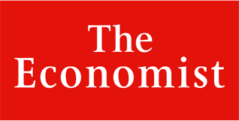
AJK
14 School Units
Making Our Mark
1,921 school units
KPK
87 School Units
64 districts across Pakistan
Baluchistan
87 School Units
Punjab
780 School Units
20,000+ employees
“Perhaps the largest network of independently run schools in the world.”
Sindh
953 School Units
(Impact Numbers as of 2023-24)
Notes:
This is us across Pakistan and with over 20,000 employees, the Economist recognizes TCF as perhaps the largest network of independently run schools in the world. Our employees include teachers, principals, regional and area teams including management and non-management staff at the head office.

Slide 7
The Guide to Our Journey of Purpose
Vision
Positive Change
To remove barriers of class and privilege to make the citizens of Pakistan agents of positive change
Quality Education
To bring about an enduring positive change for communities with the greatest need through:
The power of quality education, enabling moral, spiritual, and intellectual enlightenment
Creating opportunities to improve quality of life
Mission
Values & Behaviours
Sincerity - Integrity | Trust | Courage
Service - Passion | Humility | Gratitude & Forbearance
Beauty - Mastery | Finesse | Continuous Improvement
Positive Conduct - Respect | Appreciation | Inclusion
Notes:
With the scale at which we are Alhumdullilah growing, we couldn’t have done it without the support of our TCF Family. Our guide to this journey of purpose has always been mission and vision.
Our mission and vision as an organization form the vehicle that drives us to serve our purpose of bringing about a positive change for the communities we operate in, through the power of quality education.
Over the past 28 years, we have developed a unique culture that has been the indispensable ‘glue’ that holds our global TCF family together, and as we continue to grow in scale and complexity, this is one of the key assets we want to preserve and nurture.
Our Founders and management have been working for the past couple of years with all stakeholder groups to identify and distil what it means to be part of TCF and articulating these values and behaviours for every member of our global movement – from supporters and volunteers to our staff members at every level of the organization and even the learners across all our schools and programs.
The values that we identified to be our guiding principles are Sincerity, Service, Beauty and Positive Conduct, and moving forward, these will continue to be our anchor and drive our actions and behaviours.

Slide 8
Our Model
Driven by our ethos and culture to bring positive change
Serving the most deserving
Embedding purpose-built schools in communities to provide quality education
Ensuring an all-female faculty in schools to maintain female student ratio
Providing holistic student and alumni development
Uplifting communities with various development programmes
Ensuring quality of professional management and transparency in reporting
Building fundraising sustainability through relationships
Notes:
Guided by our unwavering commitment to core values, TCF seek to transform lives through the transformative power of quality education.
We achieve this by establishing purpose-built schools in the heart of marginalized urban slums and rural communities, ensuring accessibility and affordability, and maintaining a balanced gender ratio with an all-female faculty, proudly making us one of the nation's largest female employers.
The true measure of our impact lies in the lives led by our alumni and the choices they make. To facilitate their journey, we have implemented a range of alumni development programs.
Recognizing that community involvement is paramount, we mobilize community members, particularly around TCF schools, through community-based initiatives that foster trust and active parental engagement in their children's education.
Beyond our schools, a dedicated team tirelessly upholds professional management and transparency in reporting.
Our strength lies in our community of supporters, passionately connected to our cause, who raise global awareness of TCF's work, cultivating meaningful relationships to sustain our mission. Together, we strive to bring about positive change and empower deserving individuals through the enduring force of quality education.

Slide 9
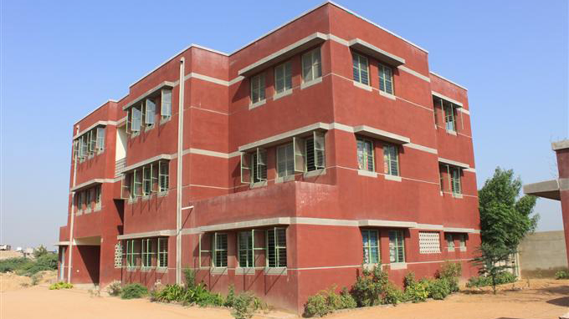
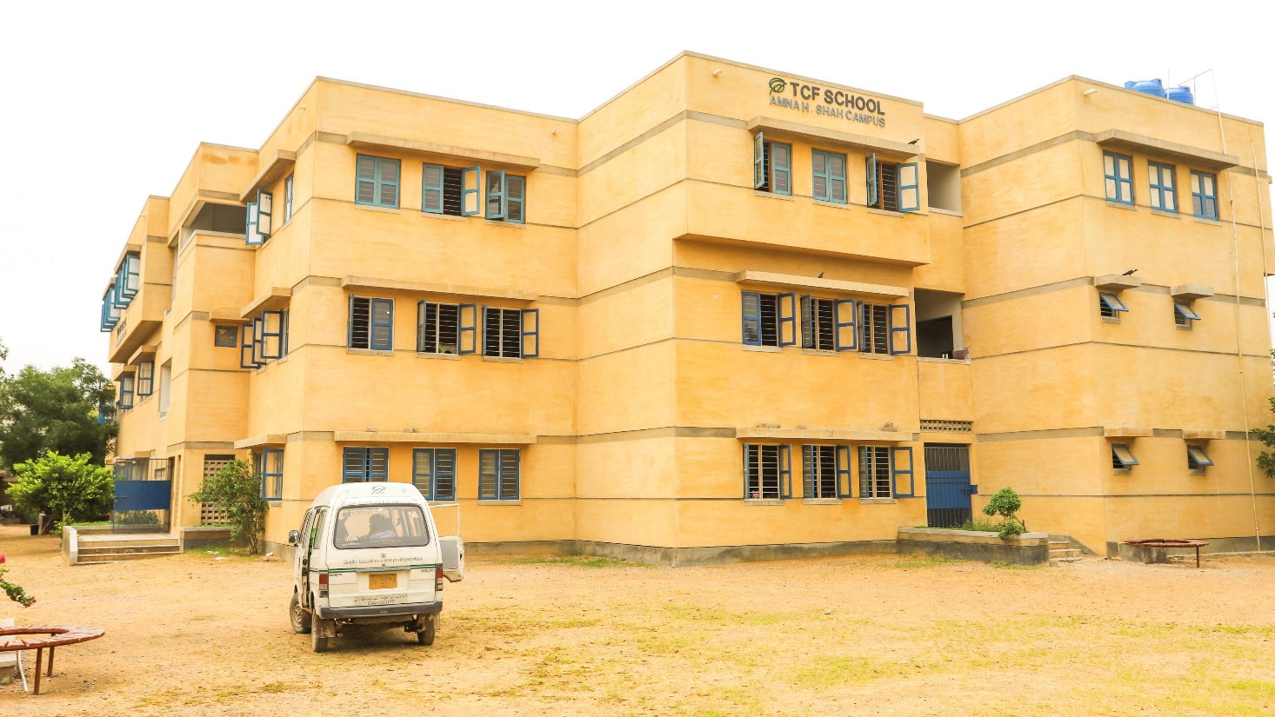
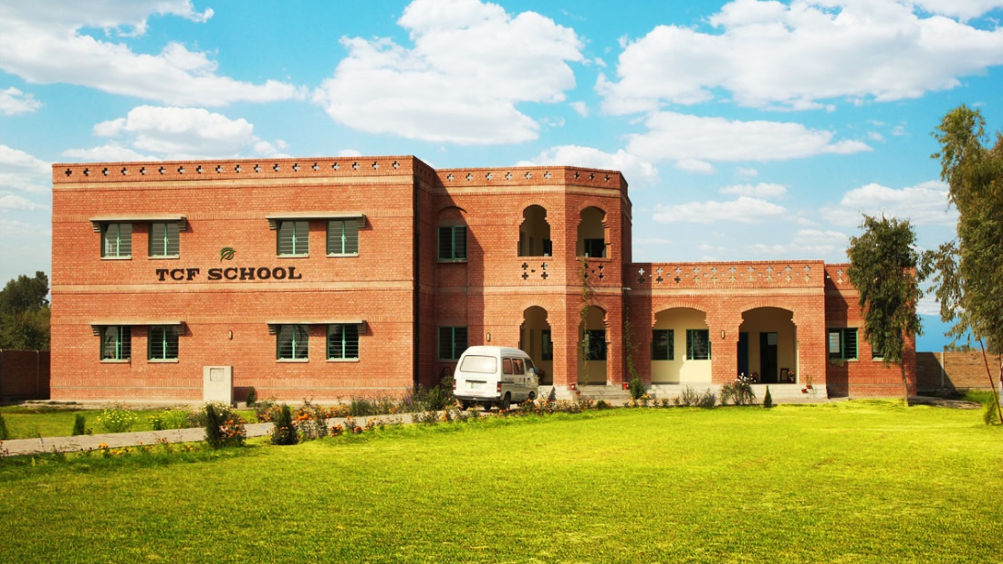
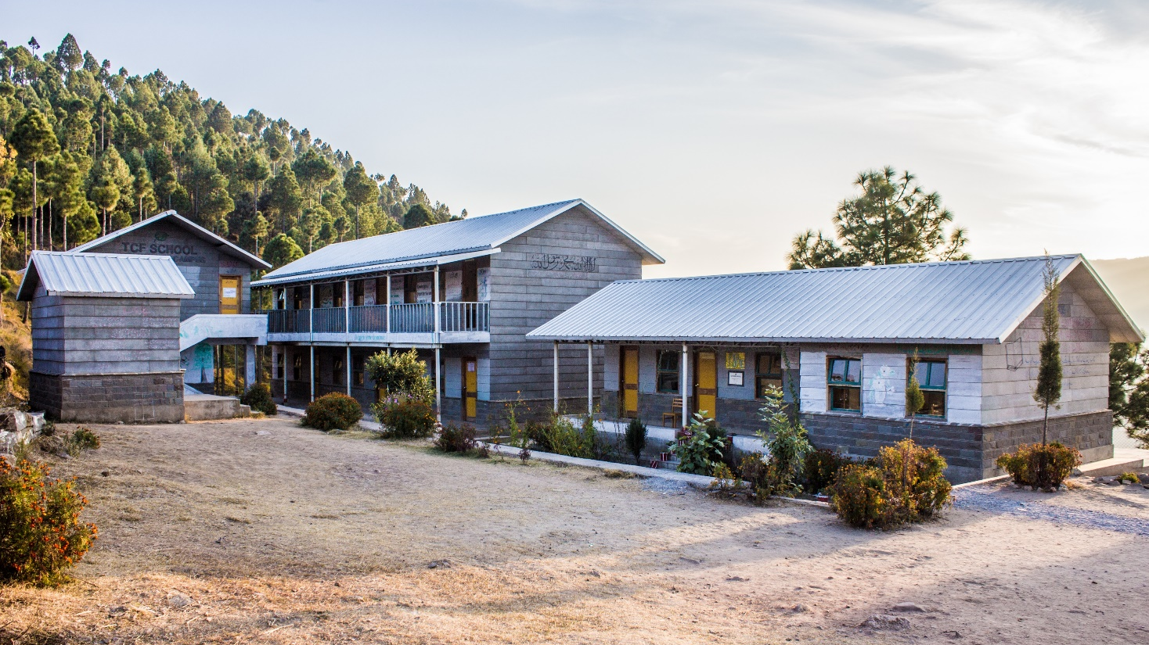
Formal Schooling Programme | Flagship Schools
Notes:
At The Citizens Foundation, Pakistan, our unwavering commitment to quality education and community engagement drives our multifaceted programs. Foremost among them is our formal schooling initiative, where we seek to revolutionize education in Pakistan by addressing access, quality, and affordability.
Our flagship schools operate under our model, offering education at subsidized costs based on affordability, fostering a sense of active participation in learning.
We take pride in our contextualized in-house textbooks, teacher guides, and workbooks, complemented by annual teacher training in pedagogical skills and content knowledge. Our E-Learning portal empowers teachers with subject content throughout the year, and we enhance training accessibility through audio-visual rooms.
Our dedicated teachers and principals are our most significant stakeholders, and we ensure quality school leadership by benchmarking and measuring it through Teacher Competency Tests (TCTs), Principal Quality Index, Whole School Index, etc.
Governance remains paramount, with area and regional teams tirelessly ensuring operational efficiency and administrative excellence around the clock. You can get more information about our Flagship Schools Programme through a video in the Programmes

Slide 10
Access
Quality
Cost
Notes:
Transforming the Educational Landscape with AQC
Access: Taking schools to the children and serving the most deserving in the most neglected communities
Quality: Purpose-Built Schools provide a conducive learning environment for quality education
Cost: Subsidized cost of education based on affordability of the children and their families.

Slide 11
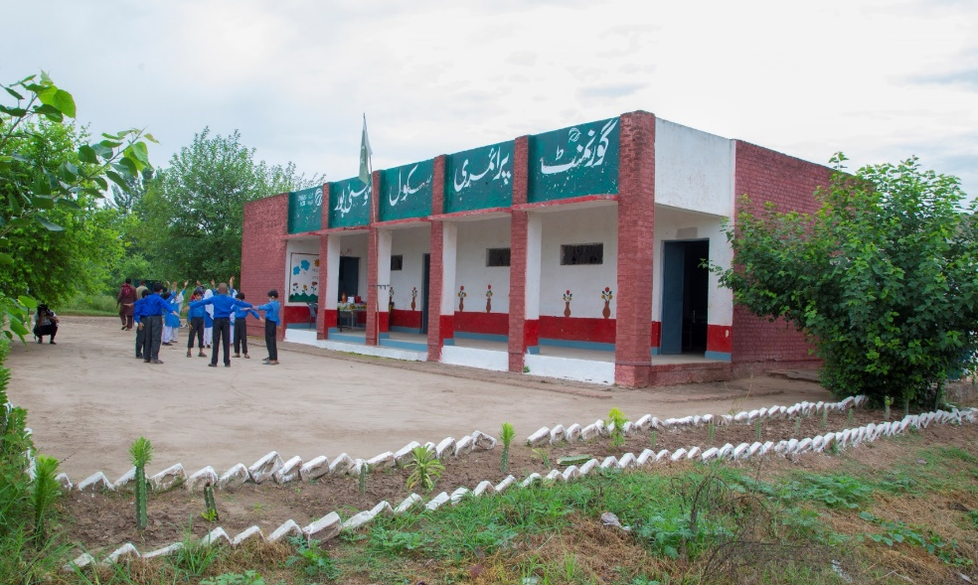
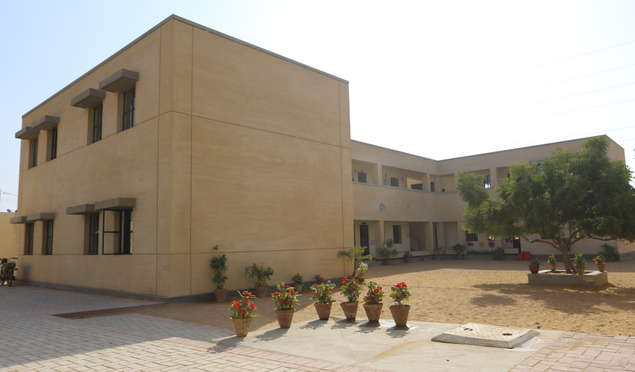
Partnership Schools Programme
Adopted Schools
Foundation Assisted Schools (FAS)
Notes:
Moving on to another mammoth segment of ours which is the Partnership Schools Programme:
We developed a Strategic Development Unit (SDU) which looks beyond our core program, and into the prospects of adopting and reforming government-owned schools in Pakistan, to maximize our reach and impact.
By virtue of this programme, we have over 405 school units with a total student strength of over 52,000.
There are two major divisions in how we view our schools that come under our partnership schools programme: Adopted Schools and Foundation-Assisted.
You’d be able to deep dive and learn more about this programme in our dedicated video on Partnership Schools.

Slide 12
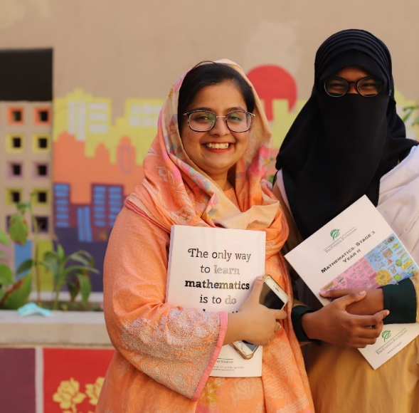
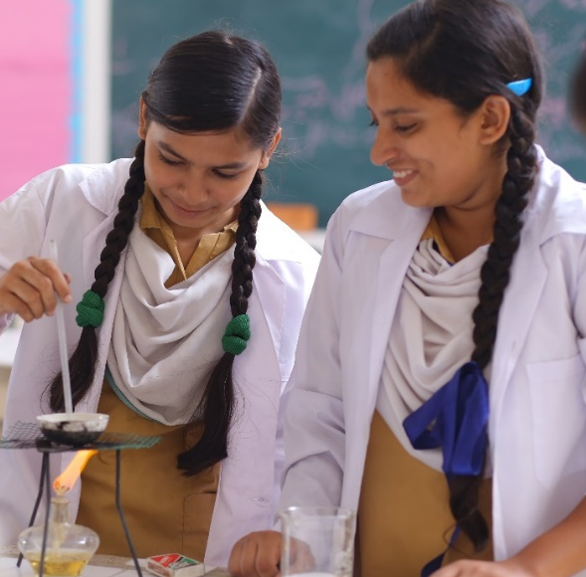
Alumni Support Programme
Alumni Connectivity
TCF College
Intermediate
Tertiary Scholarship
Tertiary Support
12
Notes:
We, at TCF, have a strong desire to assist our children through guidance and financial means even beyond their journey with us. For this purpose and to facilitate TCF alumni in their formal and informal education prospects and career growth, we have a team working to create and sustain organization's relationship with its alumni and conceptualizing programmes that can add value to our Alumni's educational journey and career trajectory.

Slide 13
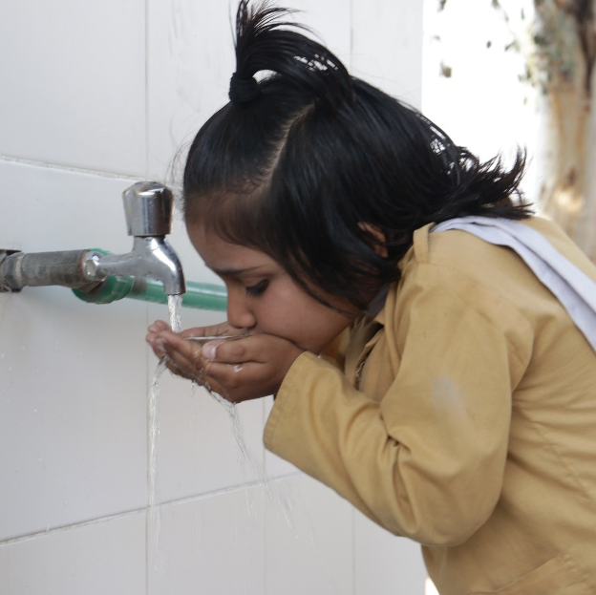
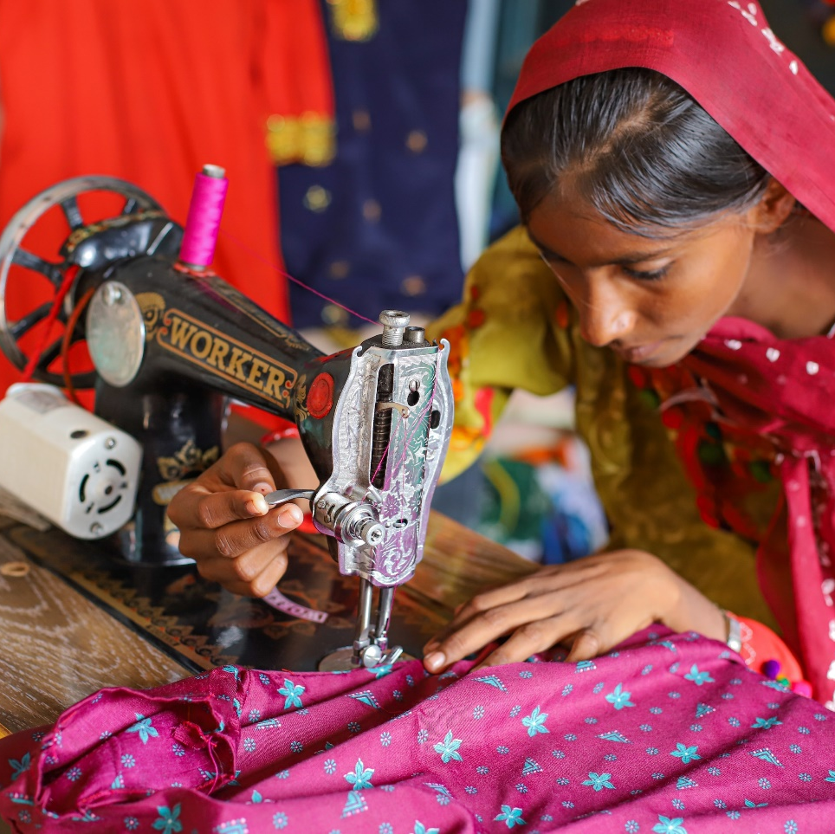
Community Development Programme
Aaghai Adult Literacy Programme
Aab-e-Rehmat Clean Drinking Water Project
Vocational Training
13
Notes:
We have a Community Development Unit at TCF which manages programs that promote poverty alleviation, preventative health, and social development in areas where TCF schools are located.
Some of our major community development programmes include:
Aagahi which is our adult literacy programme
Aab-e-Rehmat is an initiative by TCF to install water filtration plants in TCF schools, and
Vocational Training that enables women living in TCF school communities to acquire technical skills in order to achieve financial self-reliance.

Slide 14
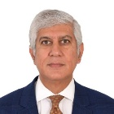
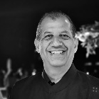
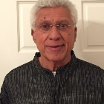
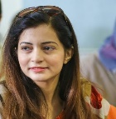
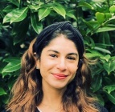
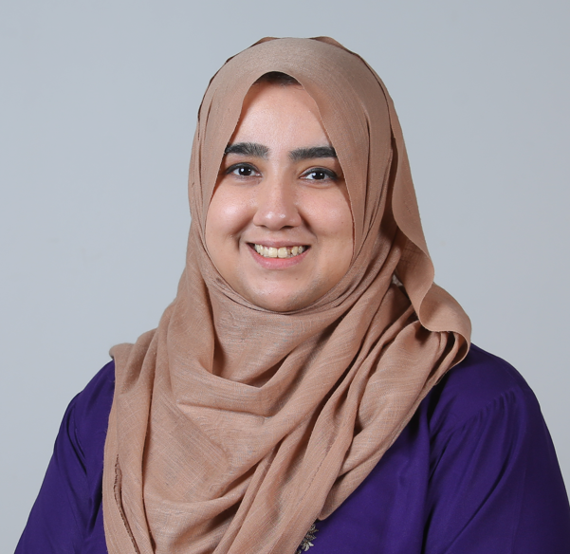
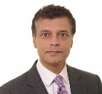
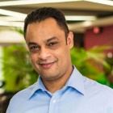
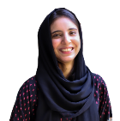
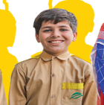
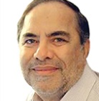
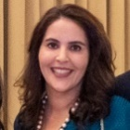
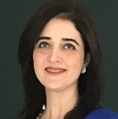
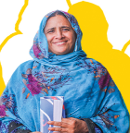
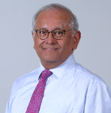
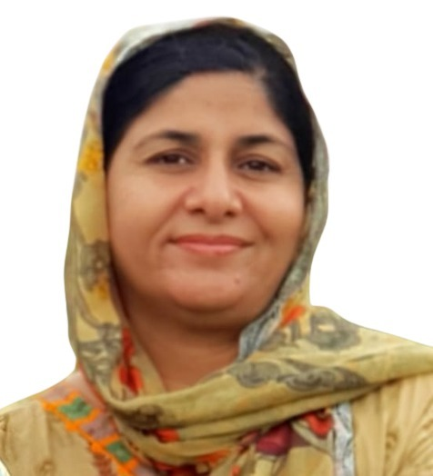
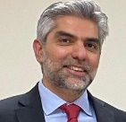
Developing Across Continents & Beyond Borders
4
Established Country Partners USA, UK, Canada & UAE
Emerging Country Partners Norway, Switzerland, Italy & Australia
4
600+
30,000
Volunteers
Donors
Notes:
Our movement goes and grows beyond borders! We now operate as one, big family of global volunteers and supporters, who, when combined, form TCF’s global community of fundraising. They form the backbone of the whole movement and operate on the mandate of not only raising awareness about our cause at a global level but bring in the funds and resources needed to sustain our mission and scale our impact.
Standing today, we are a family of 4 established country partners in USA, Canada, UK and UAE, 4 emerging markets in Italy, Australia, Norway and Switzerland and a community of over 600 volunteers and 30,000+ donors.

Slide 15
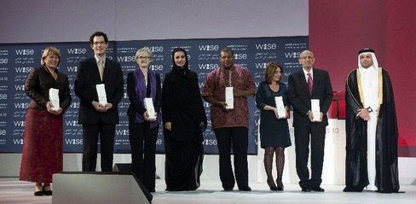
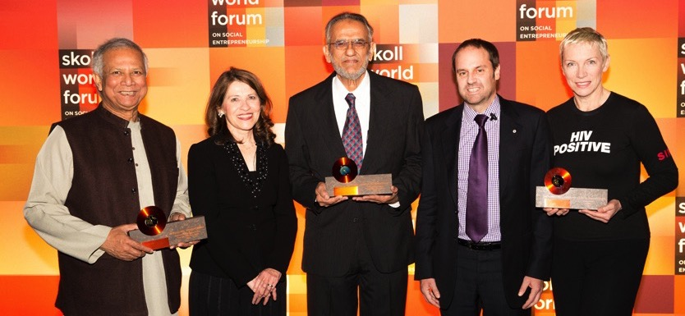
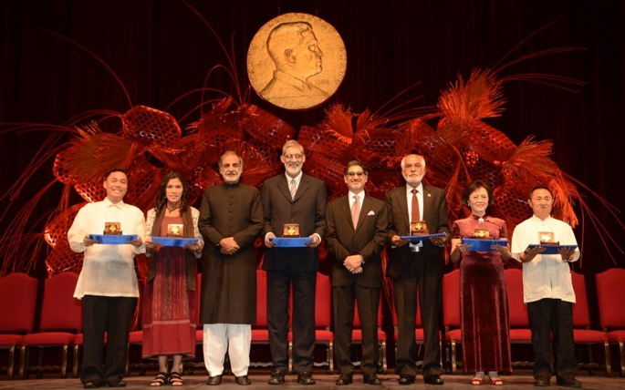
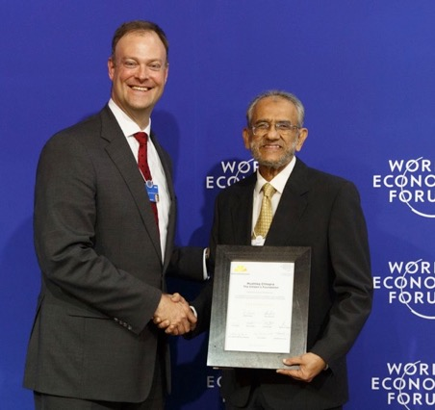
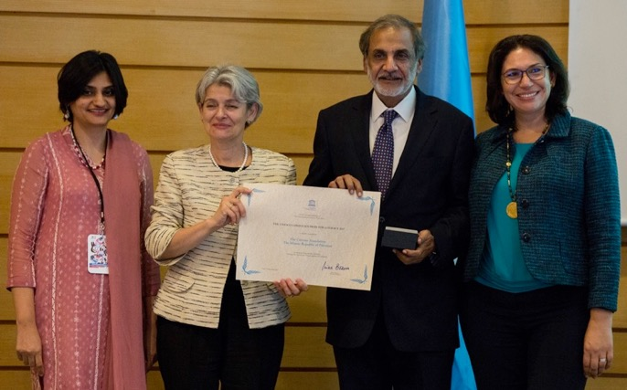
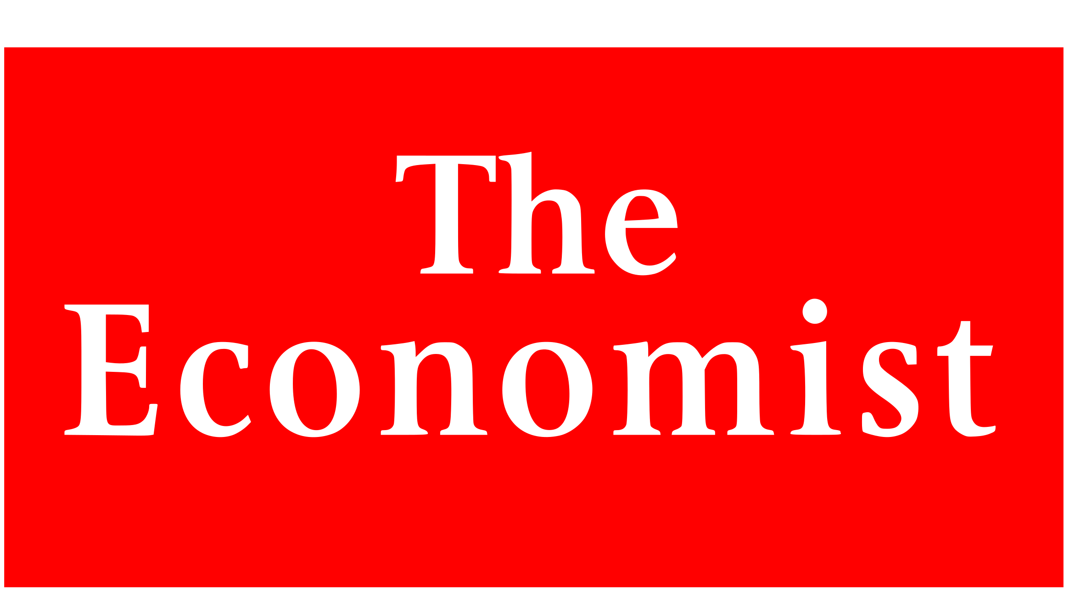
Celebrating our global accolades
In the most-populous province of Punjab, for example, nearly 100% of TCF’s pupils pass government exams, while over the last four years state schools have averaged a 44% pass rate (2010)
Wise Awards for Innovative Education Practice - 2010
Skoll Award for Social Entrepreneurship - 2013
TCF is enabling girls and their mothers from deeply disenfranchised communities to start the process by obtaining basic education needed to exercise these rights fully (2015)
Ramon Magsaysay Award - 2014
Schwab Foundation for Social Entrepreneurship - 2015
UNESCO Confucius Prize for Literacy for TCF Aagahi – Adult Literacy - 2017
Consistently awarded by professional management organizations for best management practices and governance:
Pakistan Centre for Philanthropy (PCP)
South Asian Federation of Accountants (SAFA)
The charity runs perhaps the largest network of independently run schools in the world, educating 204,000 pupils at not-for-profit schools (2018)
Notes:
TCF has also been recognized for its scale and depth of impact by some of the most respected institutions in the world.

Slide 16
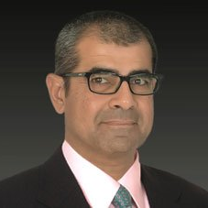
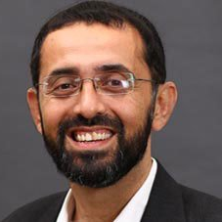
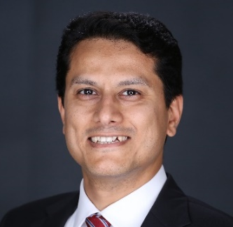
Leading
the way forward
Tauseef Ul Islam
Riaz Ahmed Kamlani
Shazia Kamal
EVP Engineering, Supply Chain and Land Management
EVP Flagship & CDU Programmes
EVP Outcomes
Syed Asaad Ayub Ahmad
President & CEO
Zia Akhter Abbas
Ghazala Nadeem
Ali Aamir
EVP Development & Partnerships
EVP HR-IT-Organization Excellence
EVP Finance, CFO & Company Secretary
Notes:
By the grace of Allah, we have been blessed with a team of passionate individuals working with us to support the cause and carry the mission forward. Leading the way forward here in Pakistan, we have an executive team of 6 individuals, managing their particular domains and inspiring their teams to become the key enablers in sustaining TCF’s mission.

Slide 17
Our Strategy 2030 | 2,000,000 Agents of Positive Change
Private & Non-State Interventions
Government Advisory & Policy Makers
Community
Out-of-School-Children
Alumni
TCF Schools
Sustainable and people-focused organization
Notes:
When we talk about sustaining our mission, we aim to achieve it, of course, with the will of Allah, but at the same time through our strategy for the future.
Through our "Strategy 2030," we aim to become a sustainable and people-focused entity while nurturing 2,000,000 agents of positive change by 2030.
Our approach is founded on three pillars: Educate, Empower, and Enable.
We maintain our commitment to school-level initiatives, alumni network development, and community development projects. To scale our impact, we collaborate with local governments, engage policymakers, and explore partnerships with the private sector, including LFPS.
Last but not least, we're determined to reach out directly to out-of-school children and develop programmes that equip them with the education and skills they need to succeed in life. To put this all into action, here are the main areas we'll be focusing on.

Slide 18
2,000,000 Agents Of Positive Change
EDUCATE
EMPOWER
ENABLE
Continue to enhance Flagship Schools programme
Scale Partnership Schools programme
Enable & support TCF alumni
Scale Aagahi by establishing more centres
Develop Sujag, a literacy & life skills program for out-of-school children
Leverage technology and digital media for learning via digital literacy programmes
Promote quality at scale in the low-fee private schooling sector by providing TCF books and scaling the publishing house
Launch Dastak, a teacher training and certification program
Notes:
Educate:
Enhance flagship schools program through network planning
Scale partnership schools program through FAS schools and focus on school infrastructure
Focus on student learning in both flagship and partnership programs
Enable and support TCF alumni through 5 different interventions
Empower:
Scale Aagahi by establishing more centers and learners whilst also focusing on quality
Scale the literacy and life skills program through doubling the number of centers and out-of-school children enrolled
Scale the digital literacy program and establish technology for the education department
Enable:
Scale publishing house through doubling the number of low cost private schools using TCF books and therefore students being impacted
Following pilot of dastak teacher training, launch basic teacher training and community building as part of programme

Slide 19
Thank you!

