Slide 1
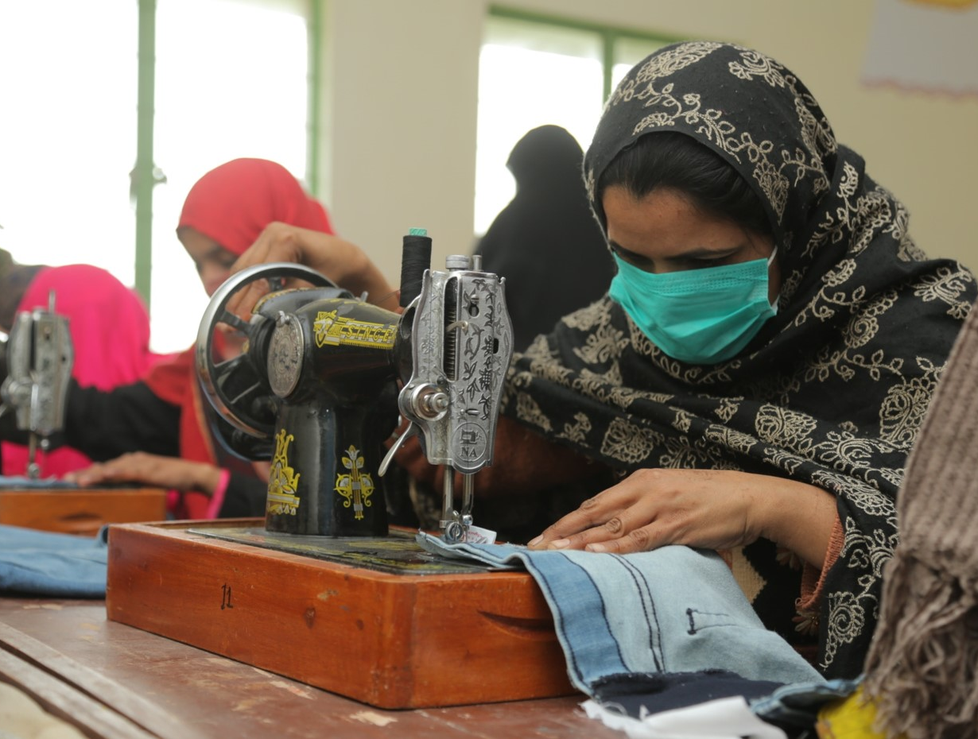
Community Vocational Training
Head Office: Plot No. 20, Sector 14, Korangi Industrial Area, Karachi UAN No.: +92-21-111-823-823
Website: www.tcf.org.pk | Email: grants@tcf.org.pk
Pakistan Registered Charity No. 0037144 | Company No. K-06597

Slide 2
About Community Vocational Training
Vision:
Poverty alleviation and social development in communities around TCF schools.
Mission:
To enable community women and girls around TCF schools to attain technical skills, enabling them to earn a livelihood and support the family income.
Impact:
To date, the Community Vocational Training program has successfully provided around 3,200 community women and girls all over Pakistan with vocational skills to practice stitching, tailoring and embroidery.

Slide 3
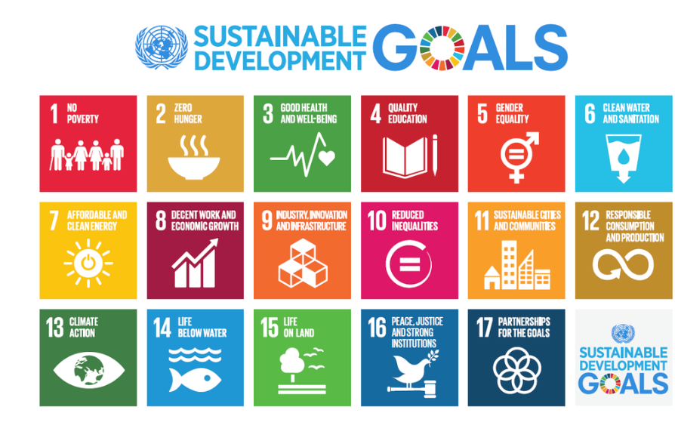
Alignment with the UN SDGs

Slide 4
Main Components of a Vocational Training Center
1 Teacher
Up to 2 Helpers
Up to 15 trainees per batch (Each center runs two batches every year)
Training and Apprenticeship:
Curriculum and Certification by Kaarvan Crafts Foundation
After course completion, vocational graduates (aged 16 or above) start:
Working from home on TCF orders
Take paid orders from their neighborhoods
Start training other women in their vicinity

Slide 5
Program Curriculum
The Vocational Training Program covers the following topics:
Fashion Designing
Cutting & Stitching
Upper & Lower Body
Dress Designing
Design Material
Adda Work
Embroidery
Color & Tones
Sketching & Illustration
Machine & Repair
Products
Frocks; Angarkha, Open & Panel Shirts; Waistcoats, Full kids, ladies and gentlemen’s suits; TCF Uniforms
5

Slide 6
Impact

Slide 7
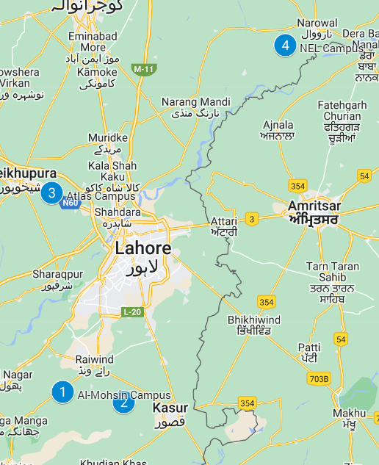
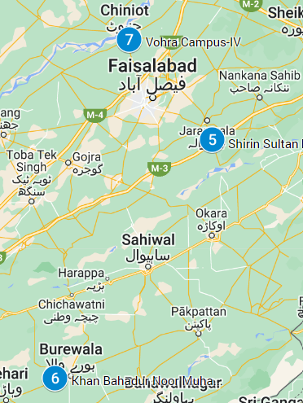
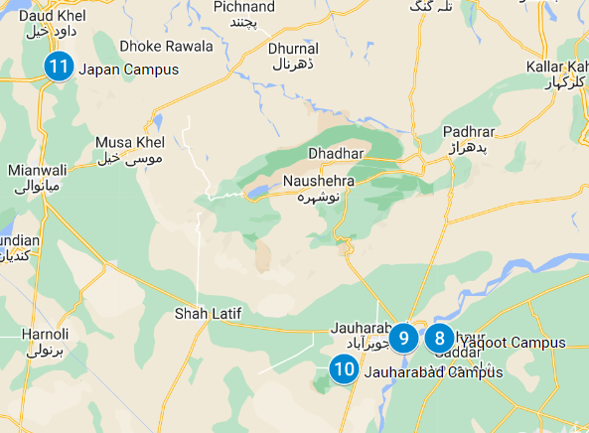
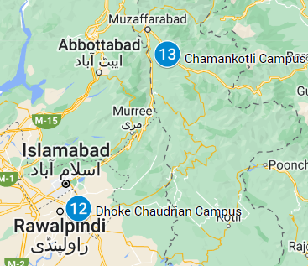
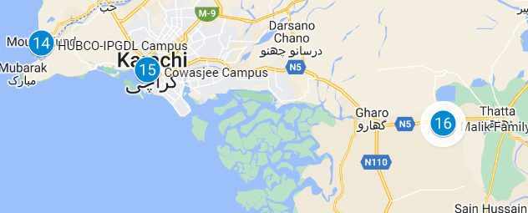
Locations
Currently, TCF is operating 19 vocational training centers for community women and girls across Punjab, Sindh, Balochistan, and Azad Kashmir
Cluster 1: Kasur,
Sheikhupura, Narowal, Kot Radha Kishan
Cluster 2: Jaranwala, Burewala, Chiniot
Cluster 3: Sargodha, Khushab, Mianwali
Cluster 4: Rawalpindi, Muzaffarabad
Cluster 5: Karachi, Sukkur, Thatta

Slide 8
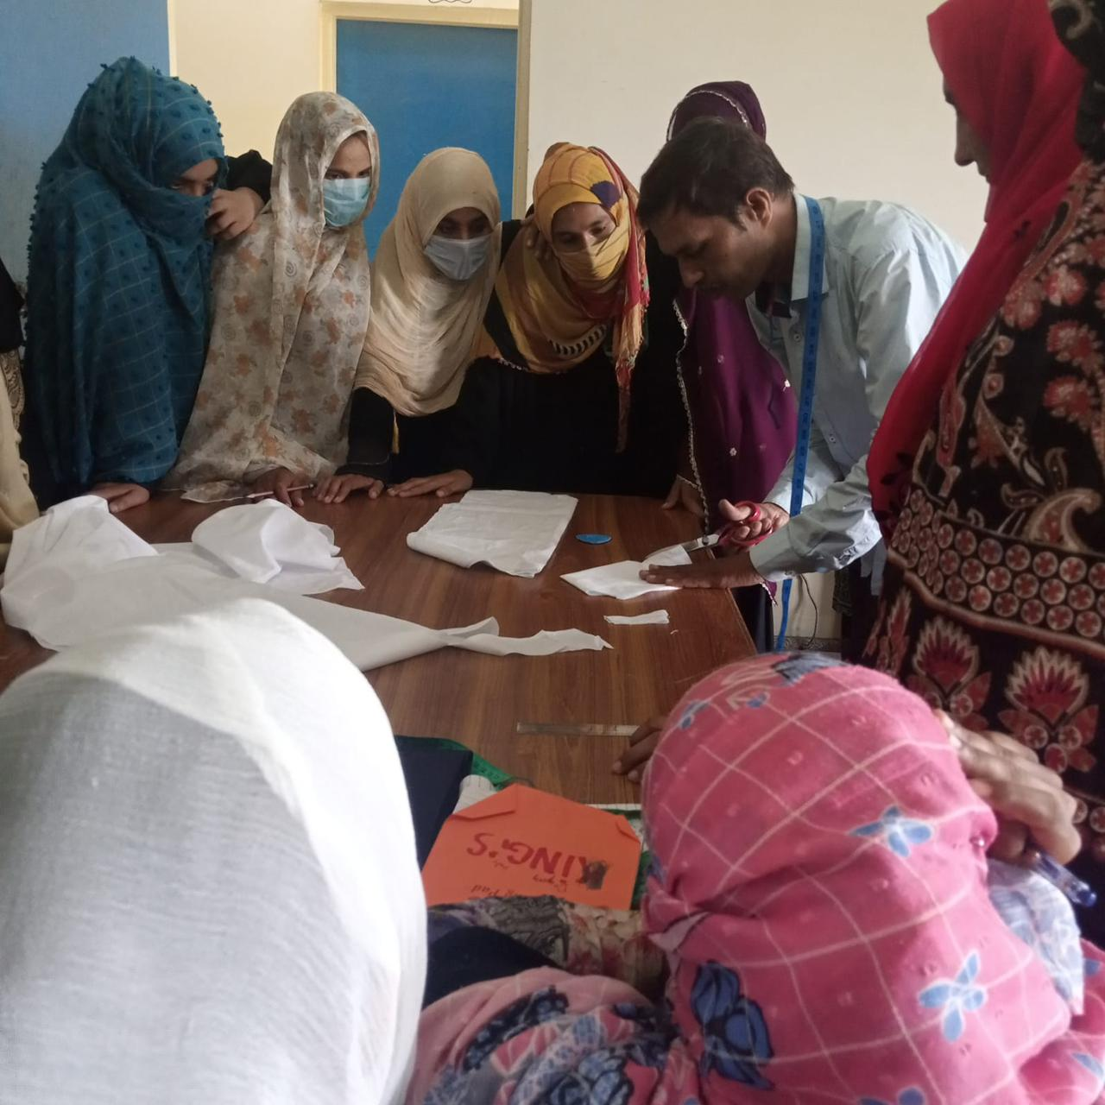
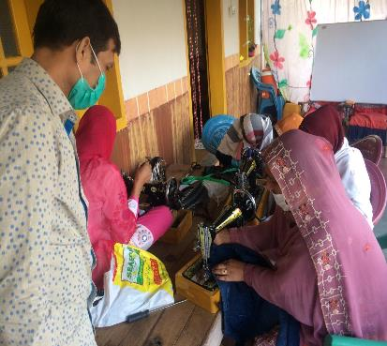
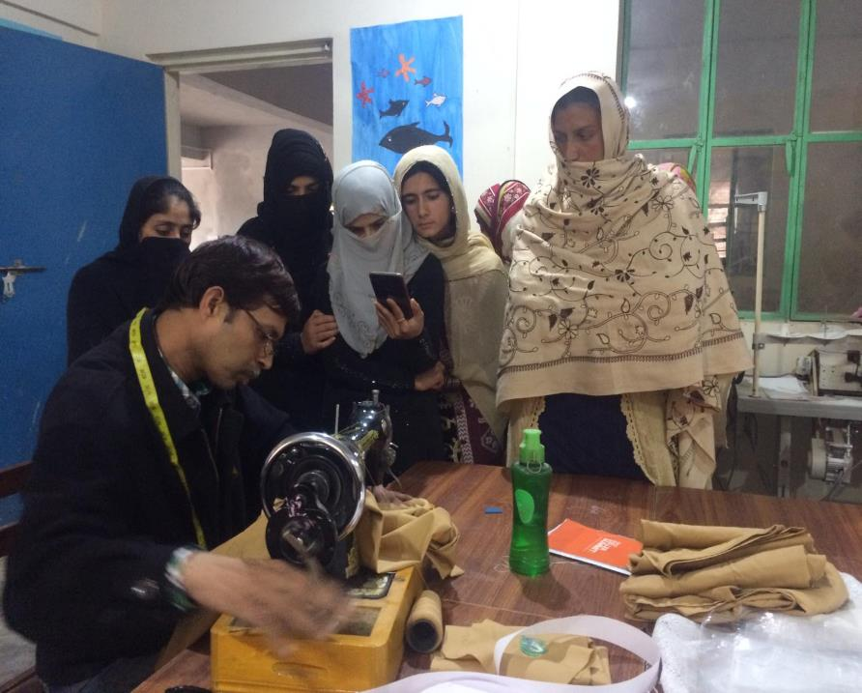
Beneficiaries
Program beneficiaries are economically disadvantaged women and girls aged 16 to 65, residing in urban slums and rural areas where TCF schools are typically situated. Majority of participants (75%) fall between 16–24 years. Typically, 83% of the participants are unmarried and at least 61% have completed Grade 10.

Slide 9
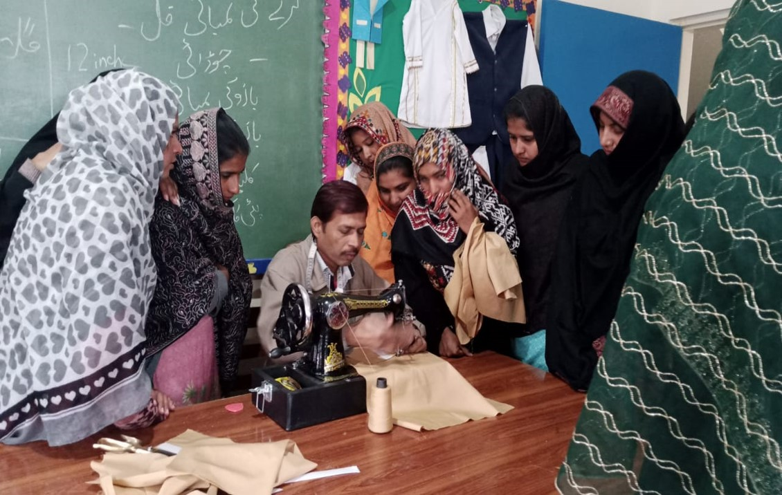
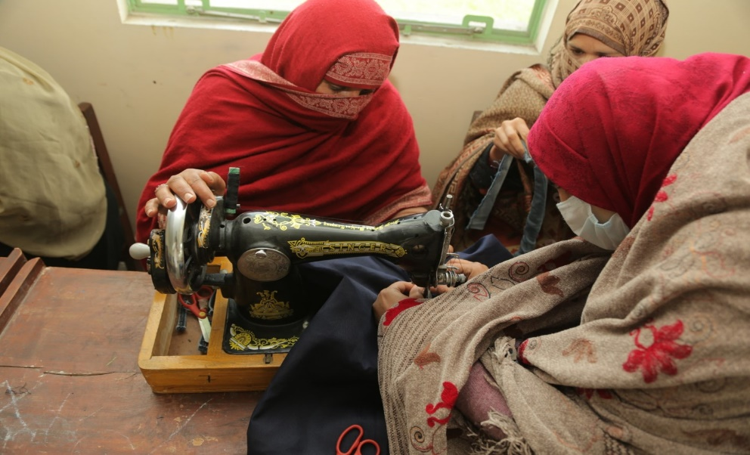
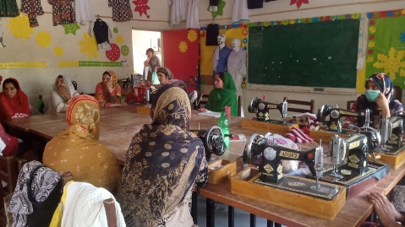
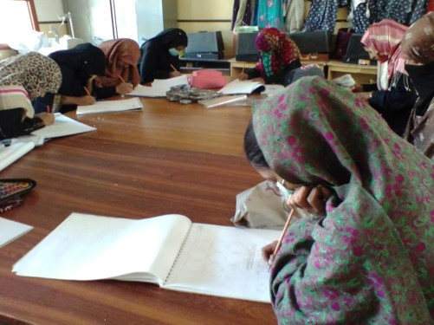
Community Vocational Training Over the Years

Slide 10
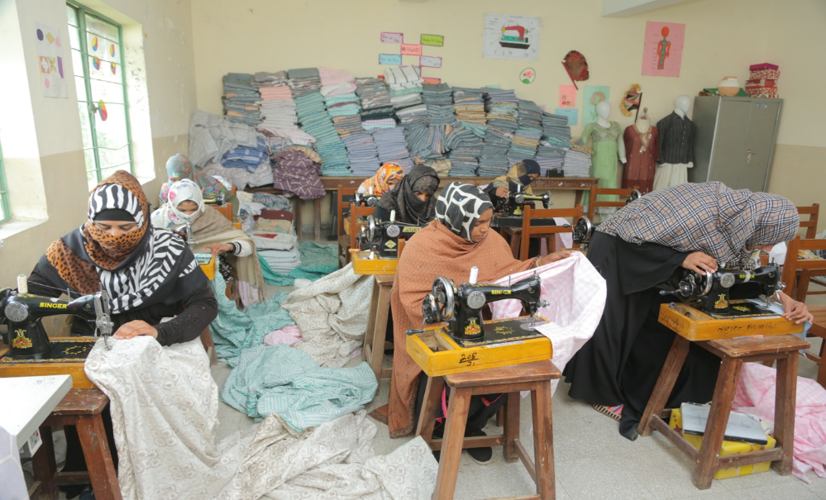
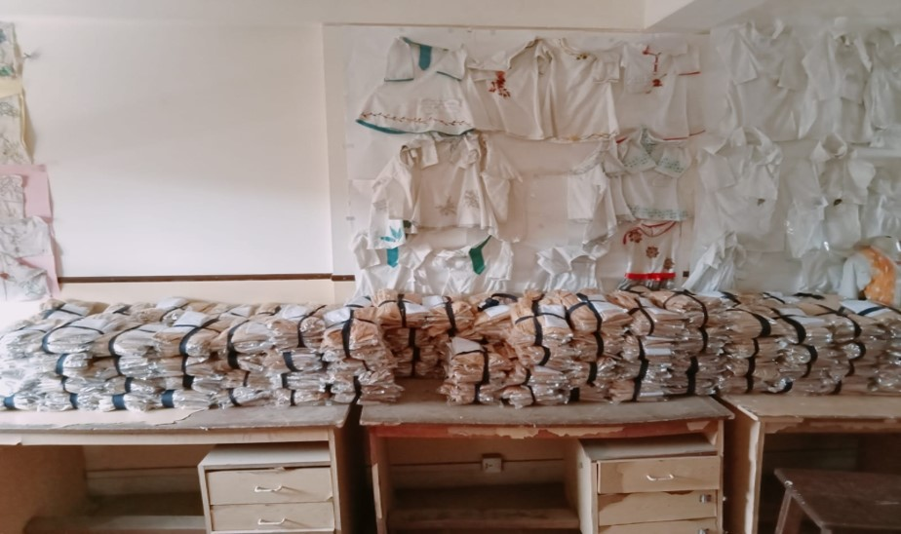
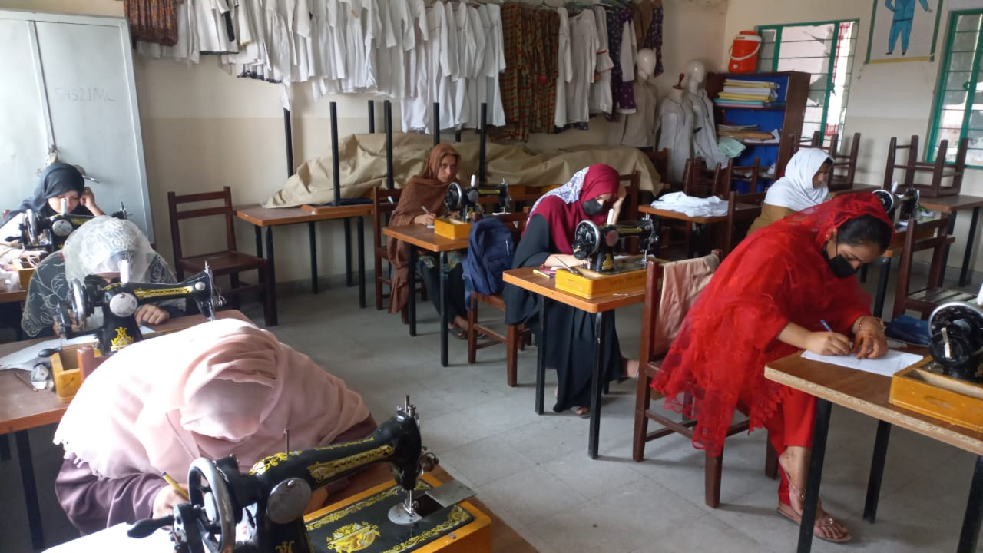
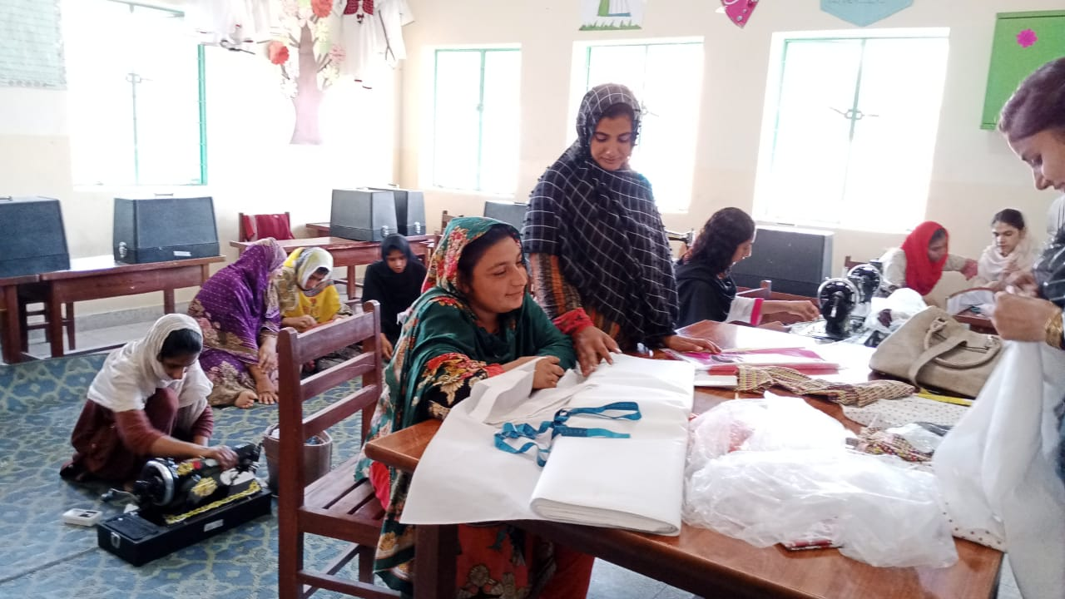
Community Vocational Training Over the Years

Slide 11
Cost of 1 Vocational Training Center 2023–24 (in PKR)
Item | Cost in PKR (rounded) | Percentage of Total Cost
Materials and Furniture Costs | 725,000 | 12%
Operations Costs (2 cycles per year) | 1,275,000 | 21%
Construction of Room | 4,000,000 | 67%
Total | 6,000,000 | 100%
No. of Existing Centers | 19
New Centers (2023–24) | 4
No. of Learners (2023–24) | 500

Slide 12
Support for Vocational Training 2023–24
The Vocational Training program at TCF needs your help! The program is run solely through donations and sponsorships. Your help is needed to provide vocational skills to deserving women and girls in Pakistan, enabling them to earn a livelihood and support the family income.
A vocational training center has the capacity to enroll up to 15 trainees and runs 2 cycles every year. Support will cover the cost of training and monitoring, salaries, books, training materials, operations, and in some cases construction and procurement of equipment and furniture.
Sponsorship Packages:
To run a vocational center (2 cycles in 1 year) – PKR 1.275 million
To set up a new vocational training center – PKR 4.725 million
To set up a new vocational training center and support for one year’s running – PKR 6 million
Progress Reports:
A year-end report (covering activities of July 2023 to June 2024) would be submitted in August 2024.

Slide 13
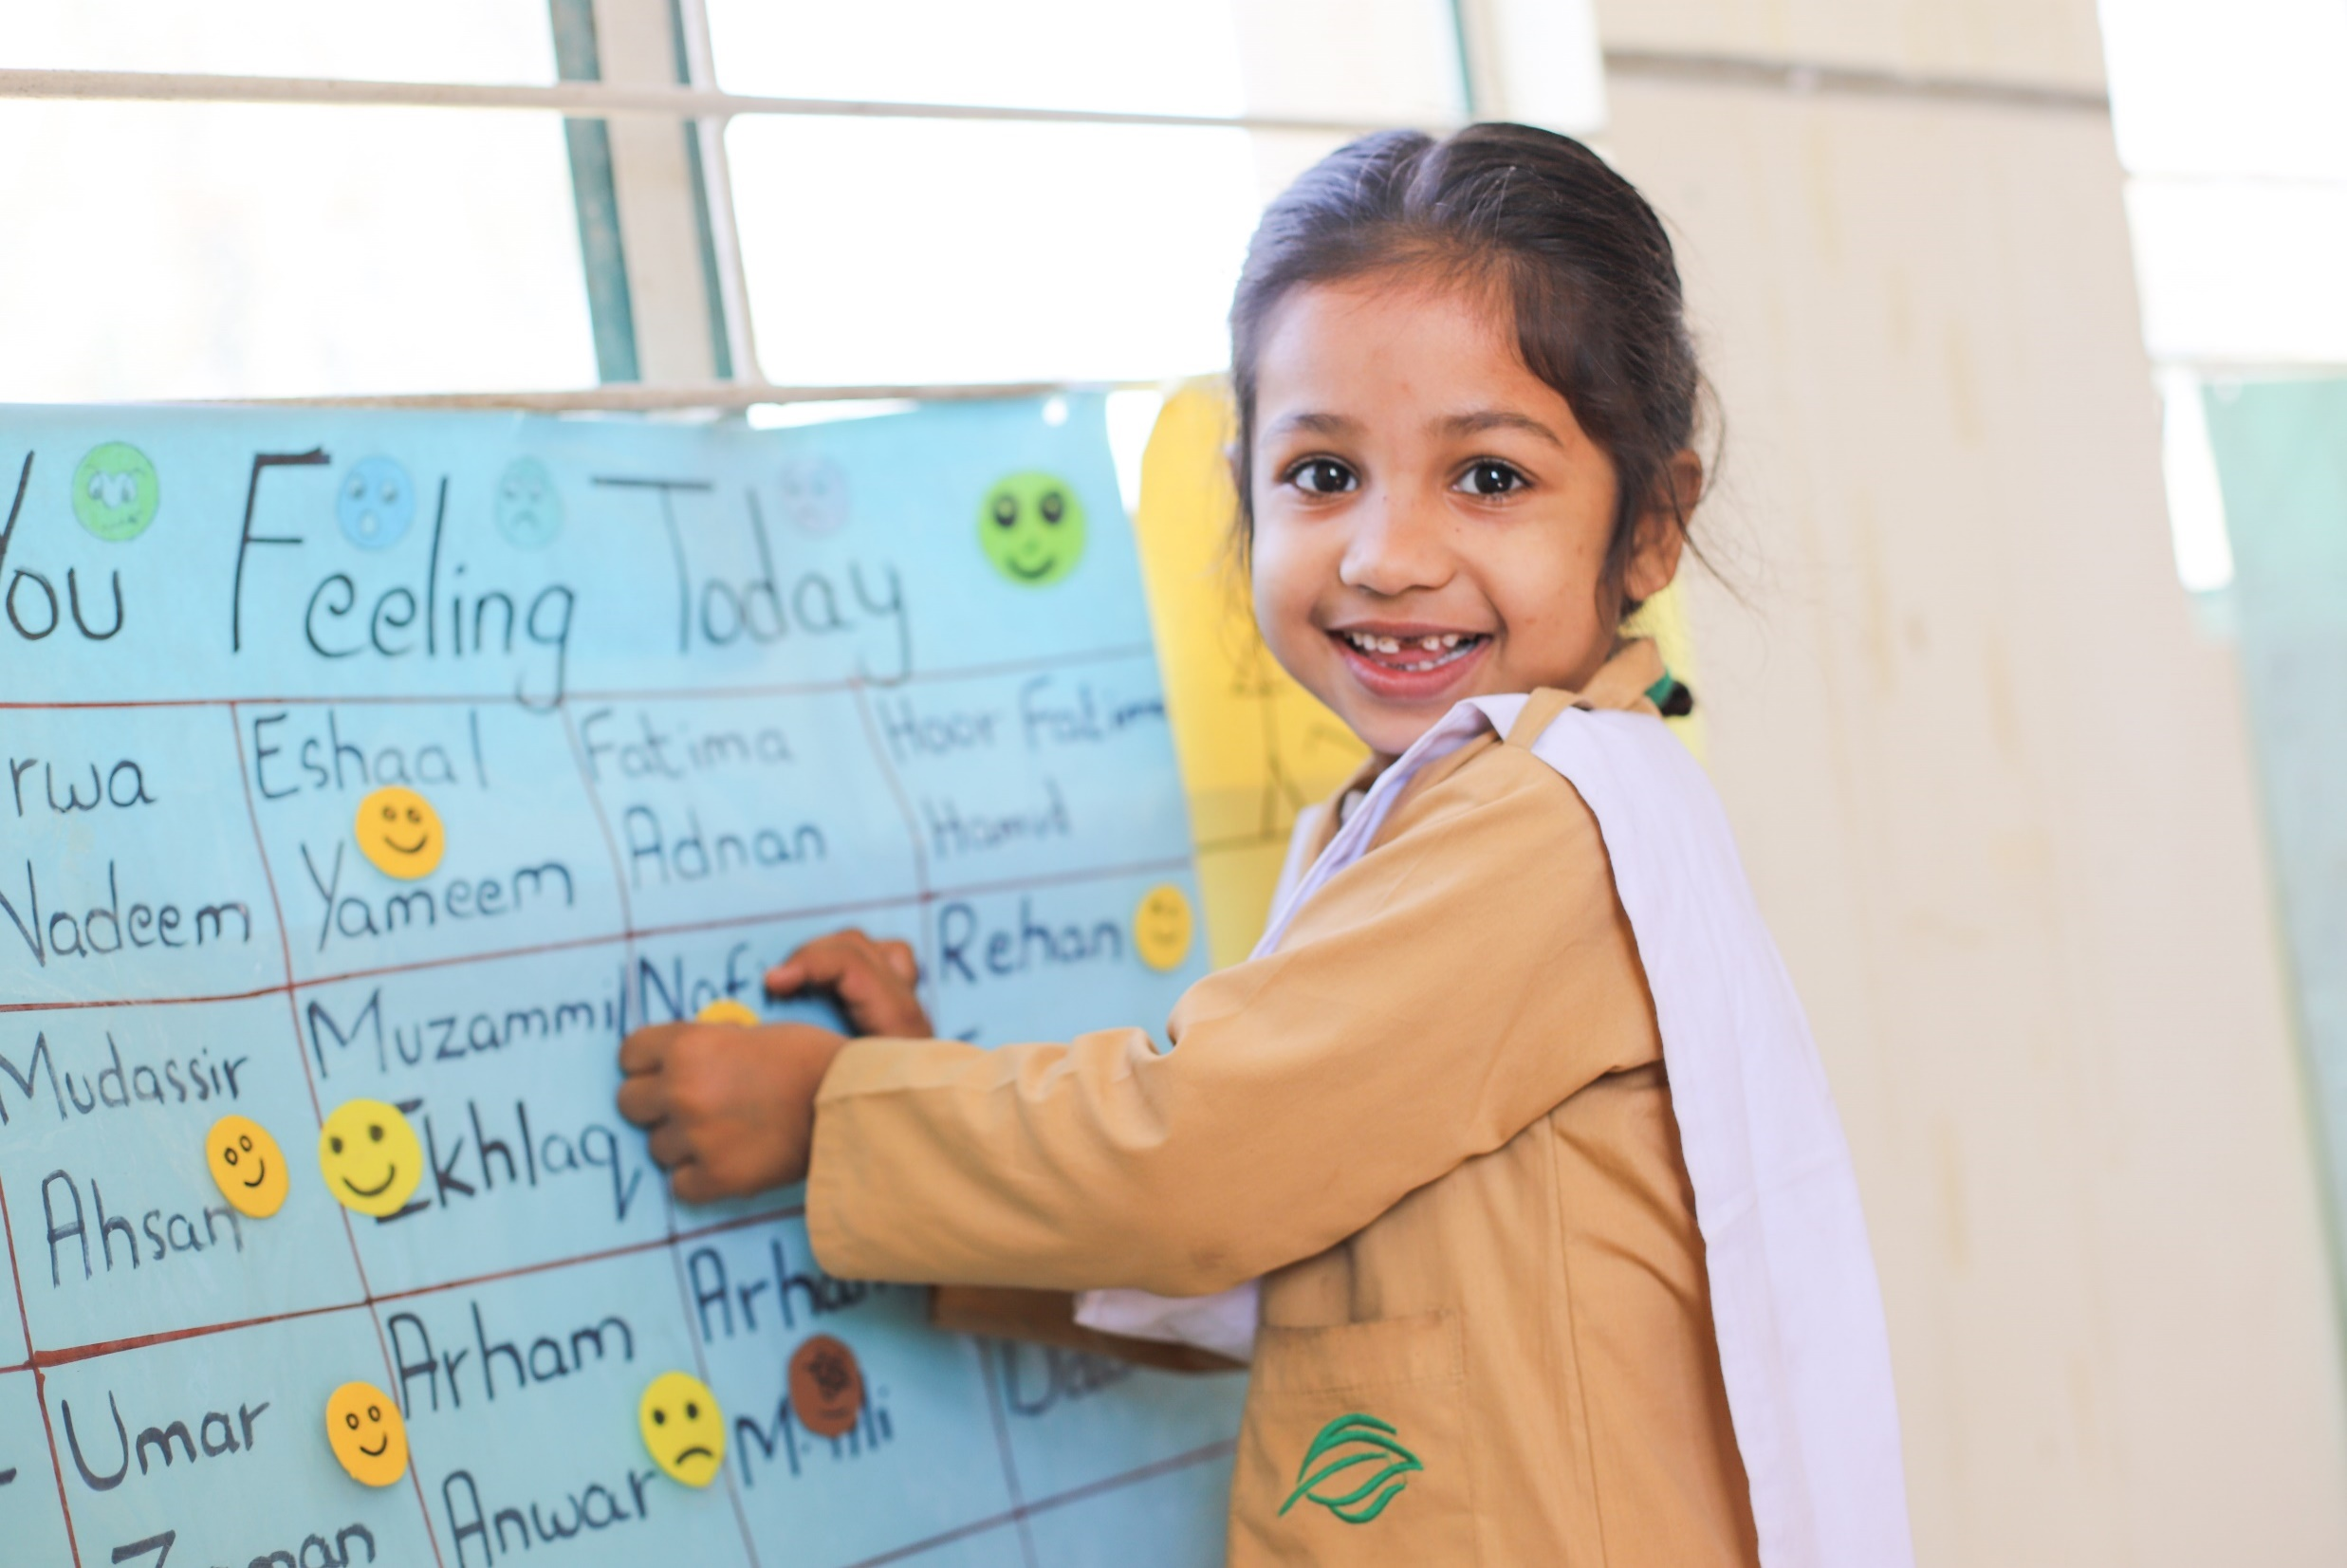
About The Citizens Foundation

Slide 14
Impact Numbers
286,000
Students
14,000+
Female
Teachers
1,921
School Units
across Pakistan
174,000
Women and girls empowered through Aagahi

Slide 15
Alumni Impact
30%
Students scored A/A+
57,000+
Graduates to date
90%
Matriculation pass rate
12

Slide 16
Impact Beyond Basic Schooling
Aagahi
Literacy for community women and girls
Vocational Training
Training community women and girls in tailoring and embroidery
Aab-e-Rehmat
Providing filtered drinking water for communities
174,000+
Learners
3,200
Trainees
19
Centers
48,000
Daily Beneficiaries
36
Filtration plants
Rahbar
Mentoring program for 8th students
Summer Camp
Fun-based learning for primary students (Grades 3, 4, and 5)
15,150+
Mentors
57,150+
Mentees
11,200+
Volunteers
77,400+
Students

Slide 17
